Slide 1
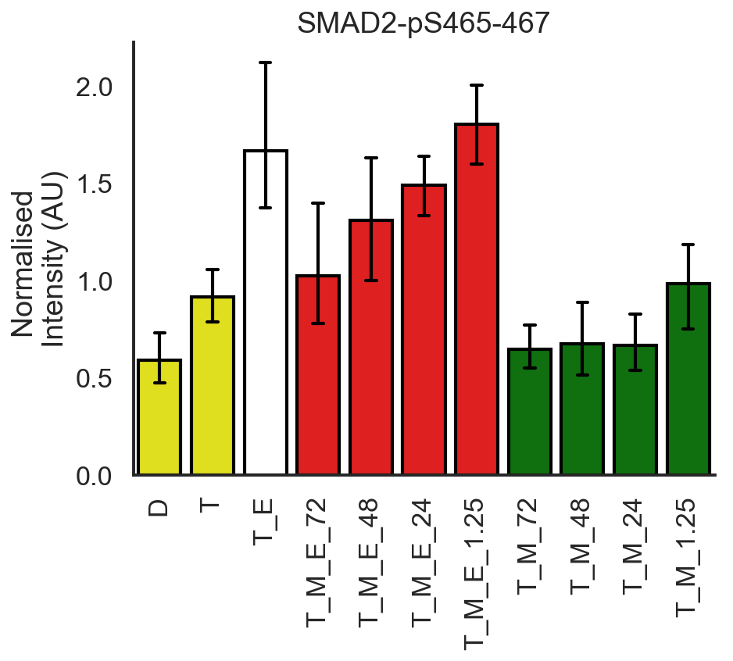
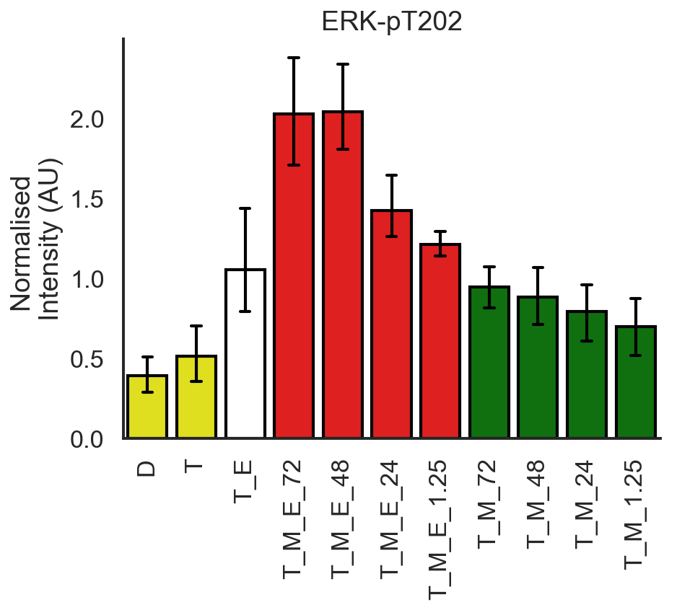
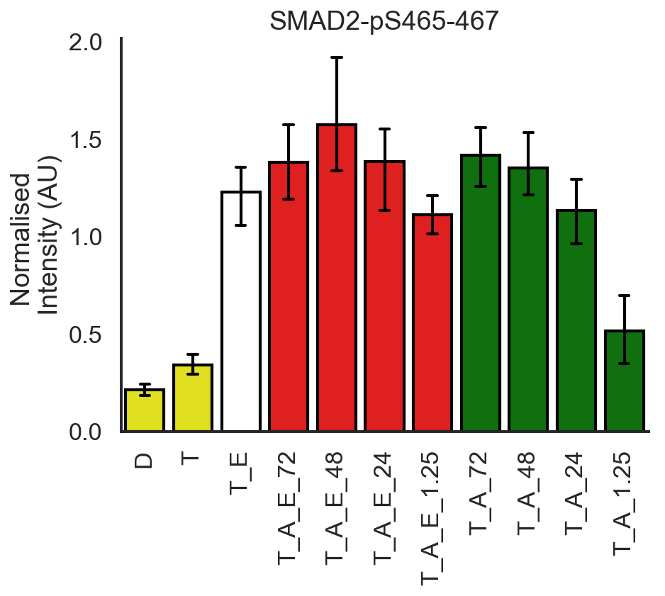
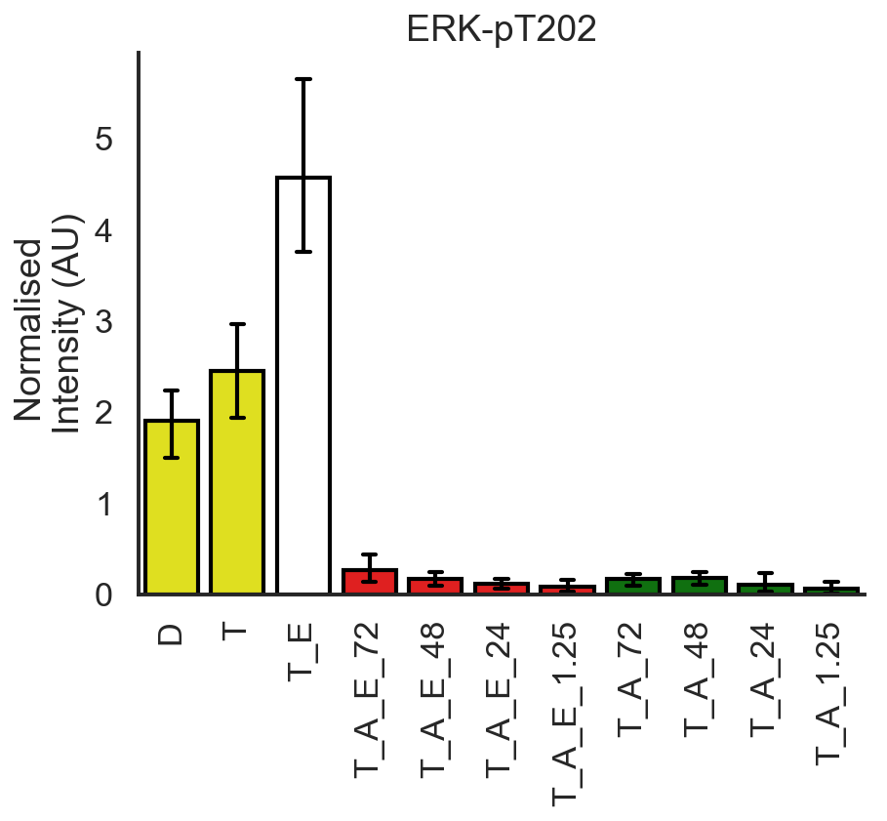
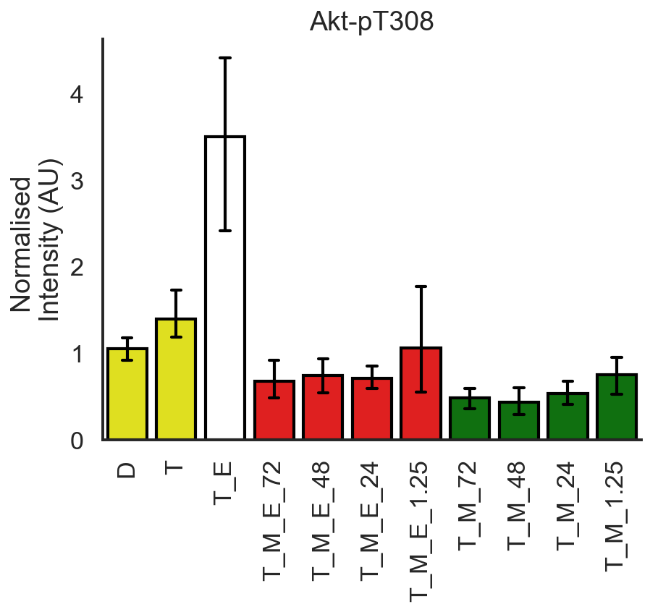
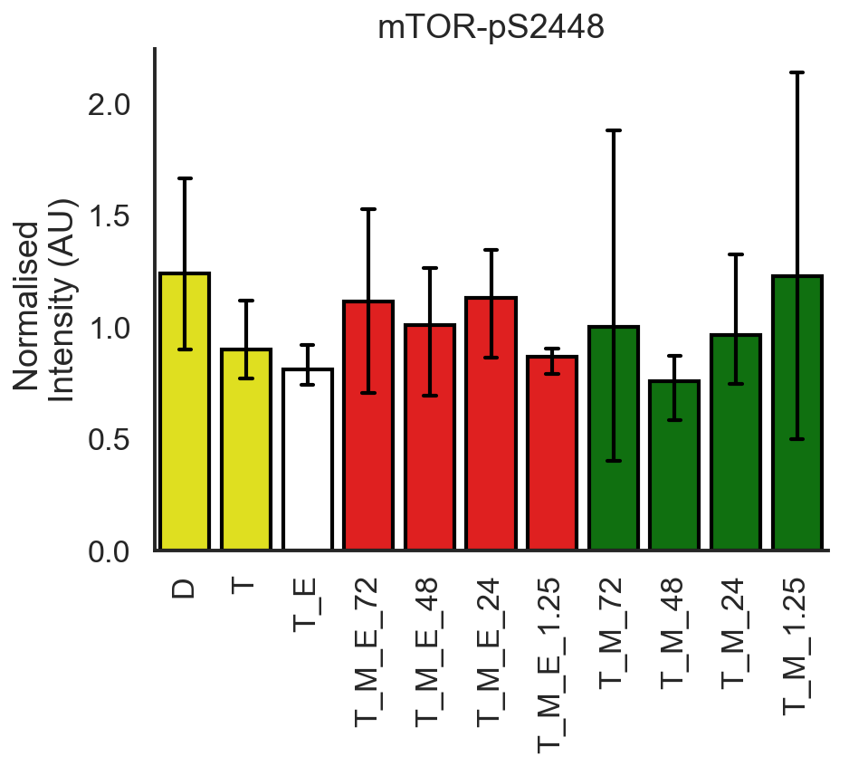
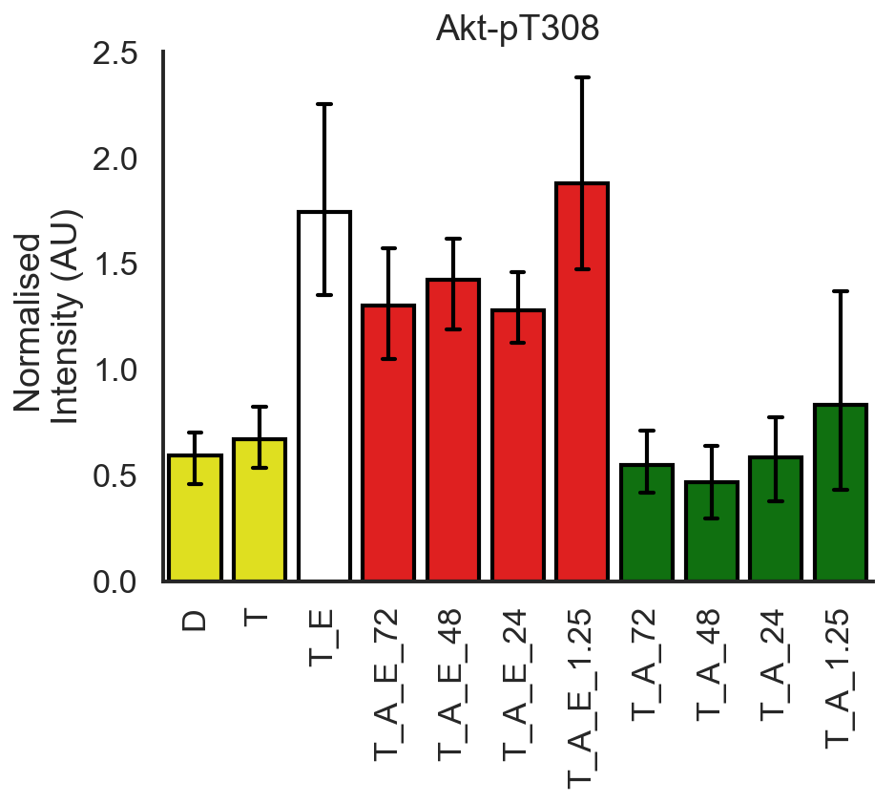
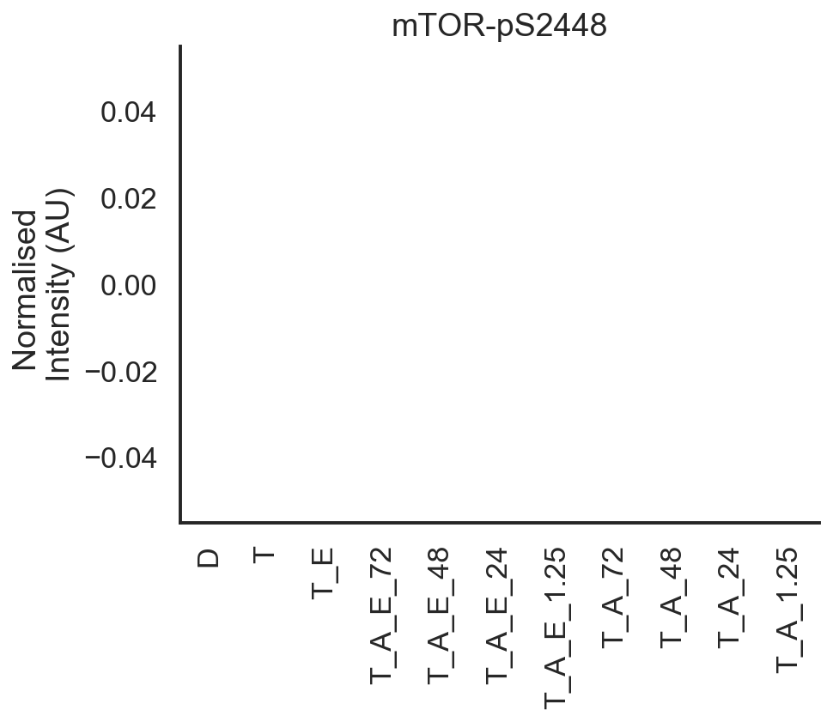
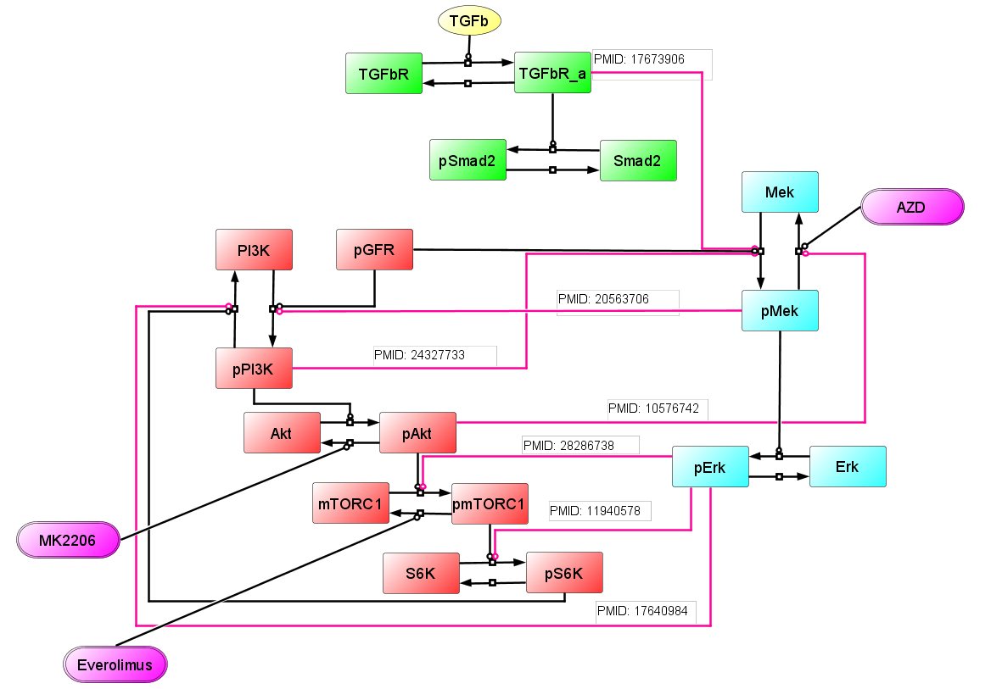
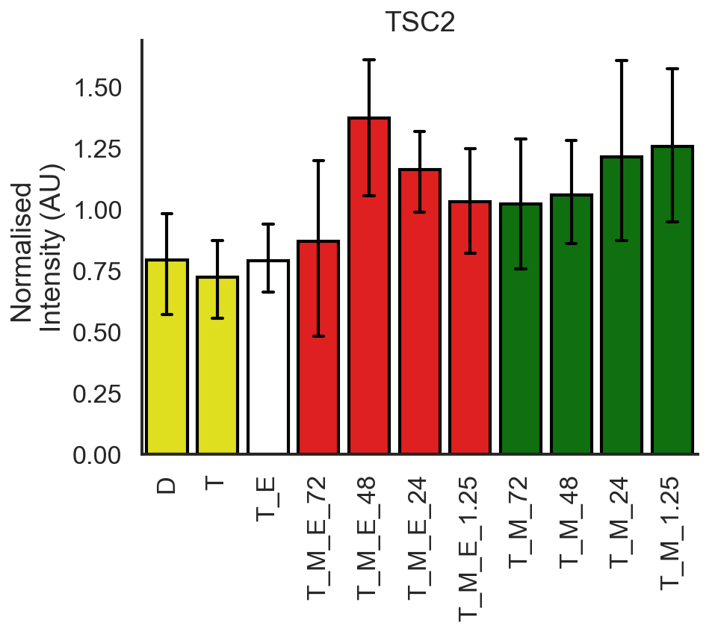
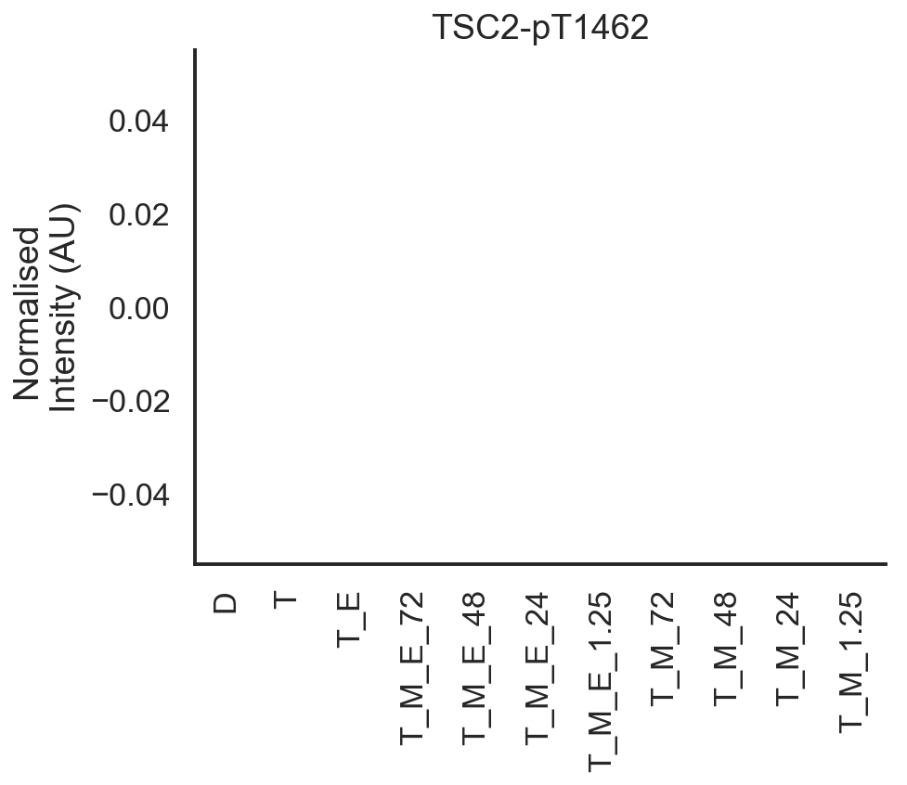
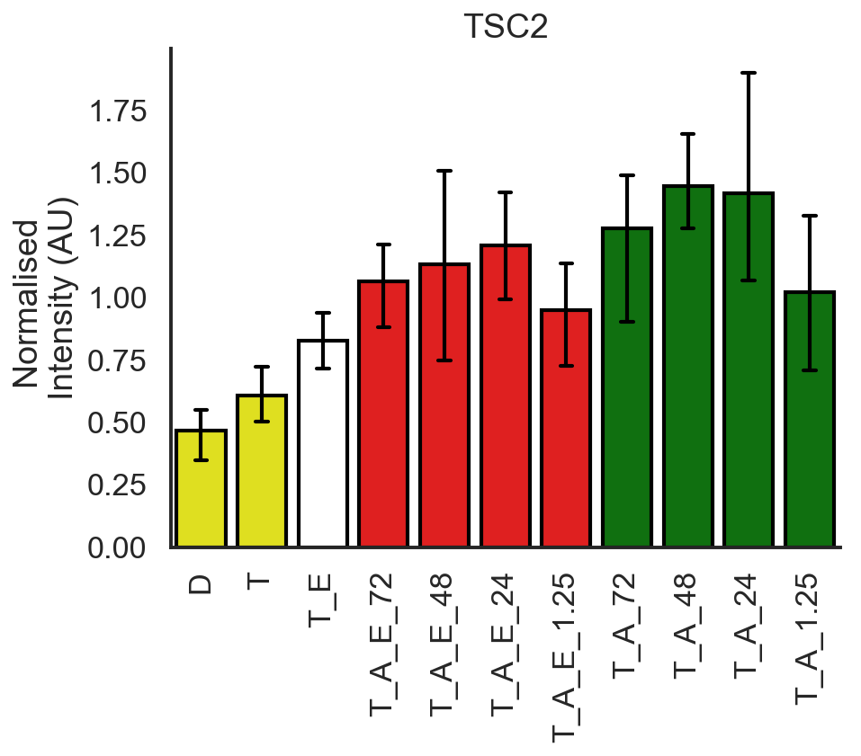
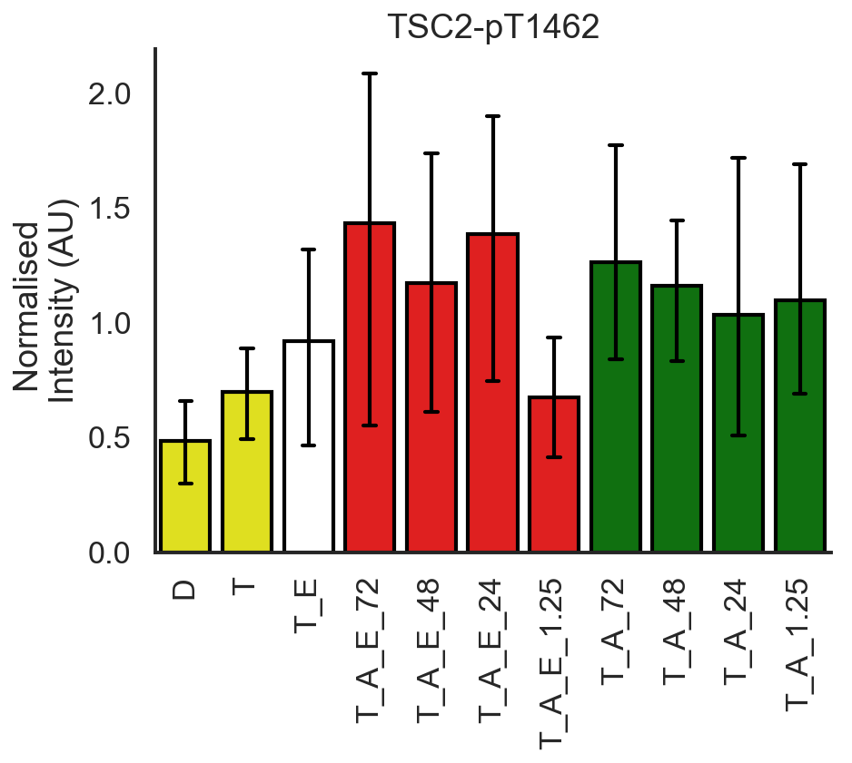
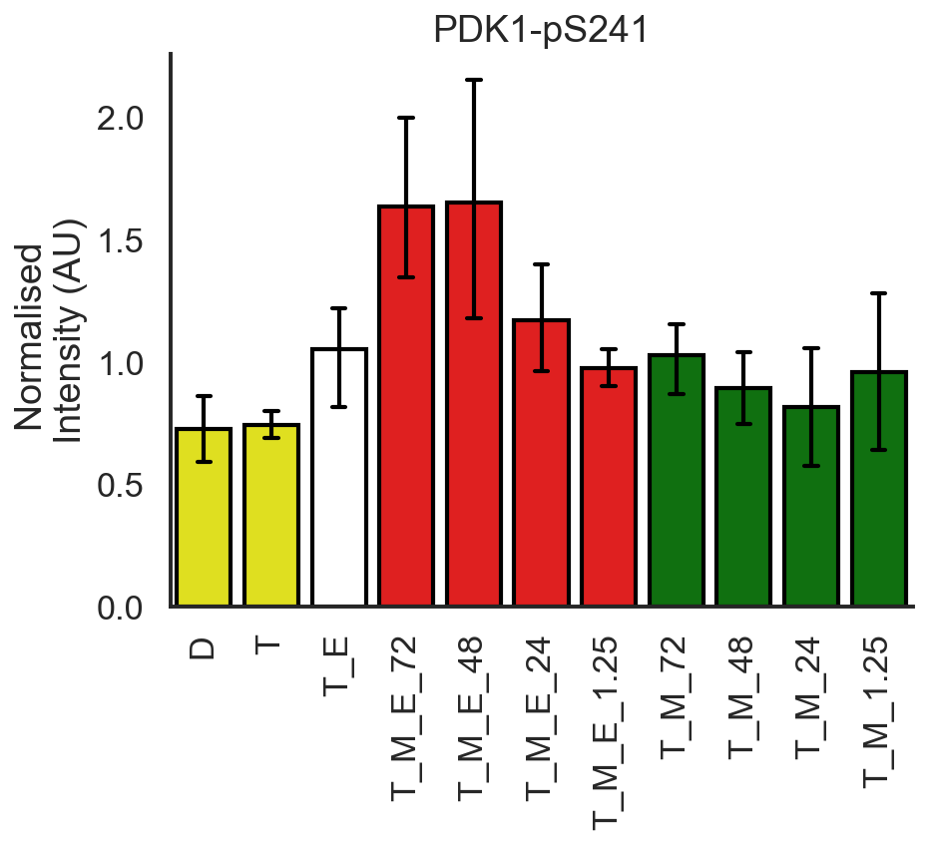
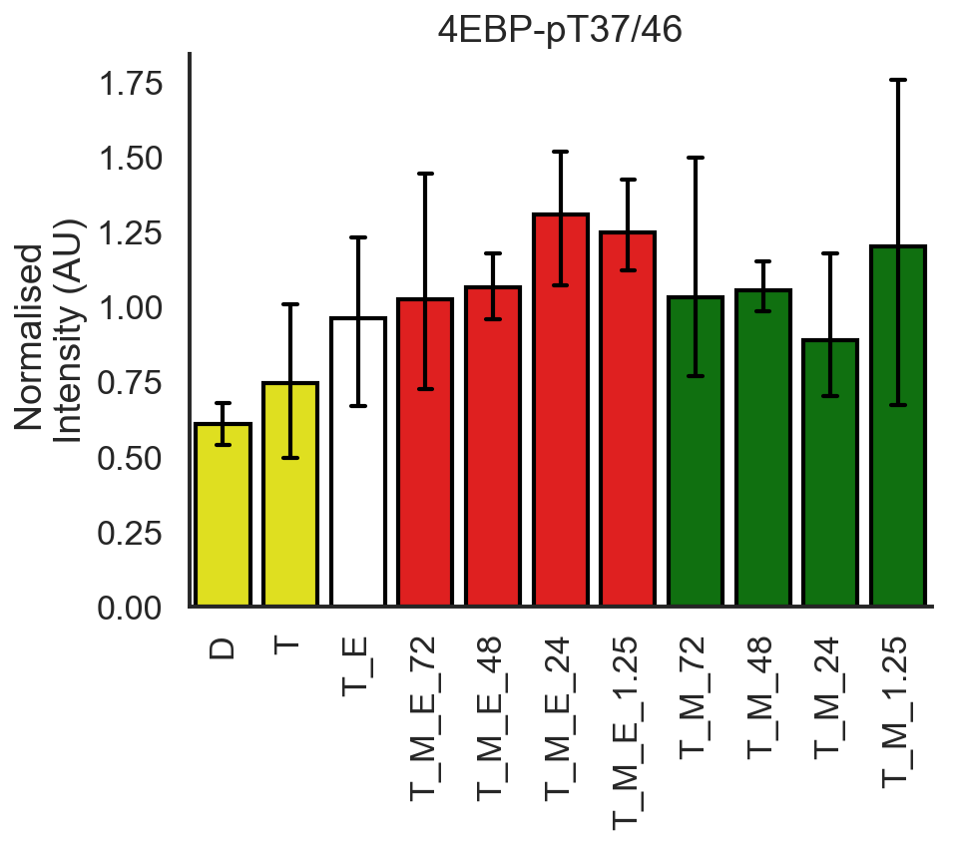
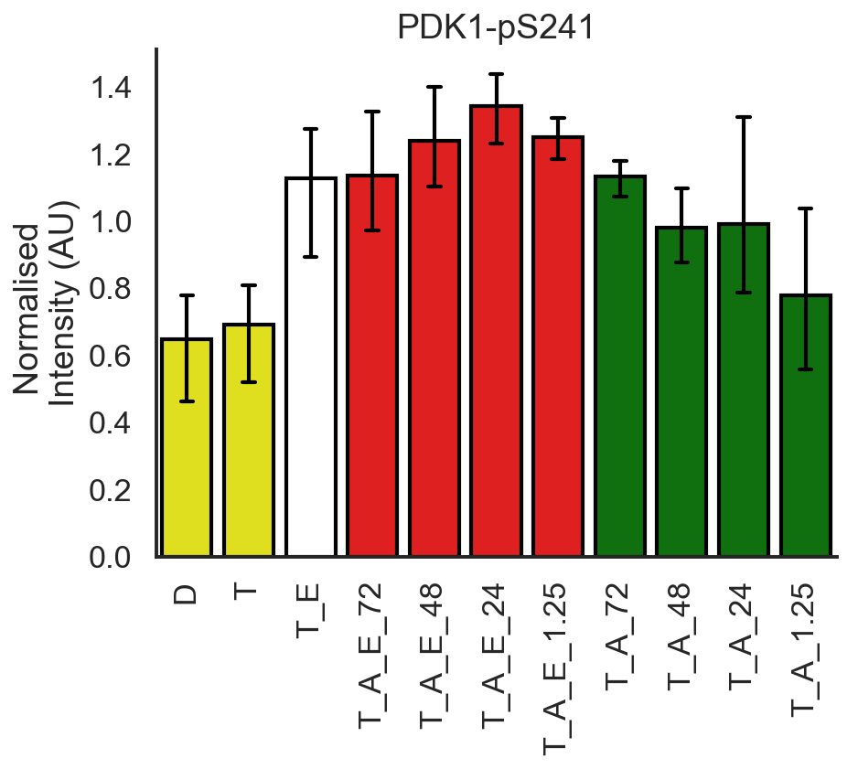
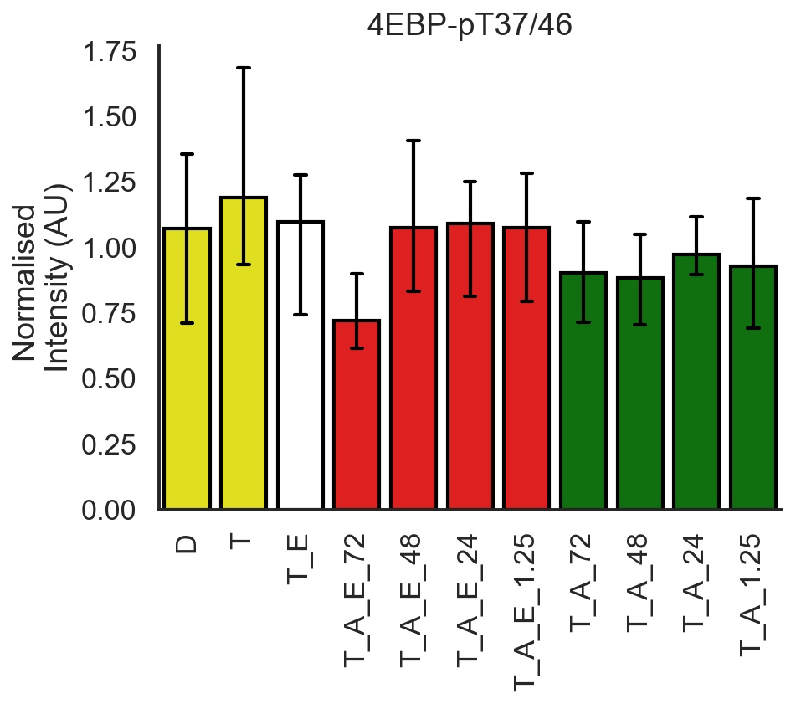
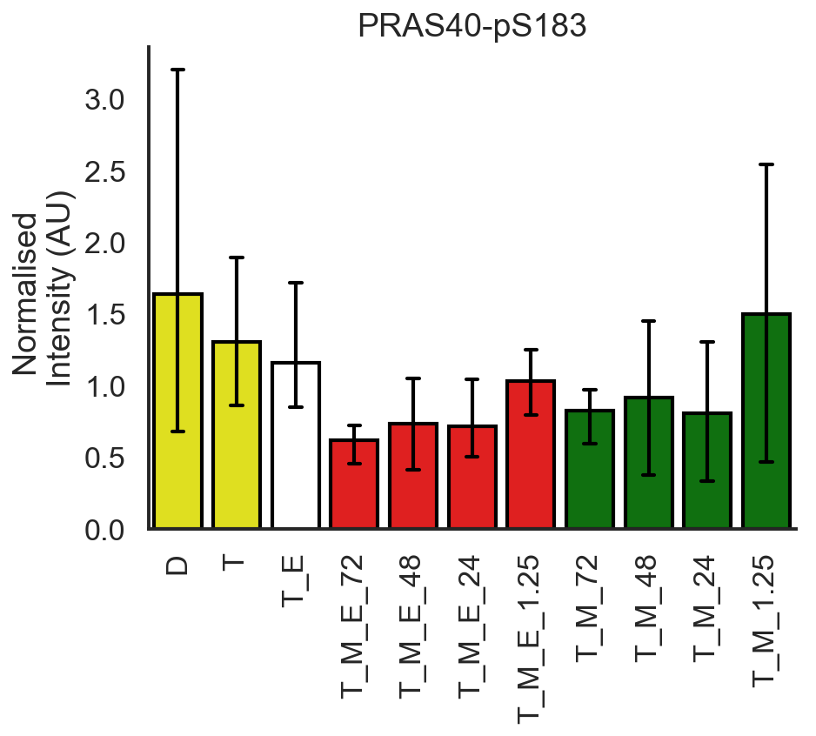
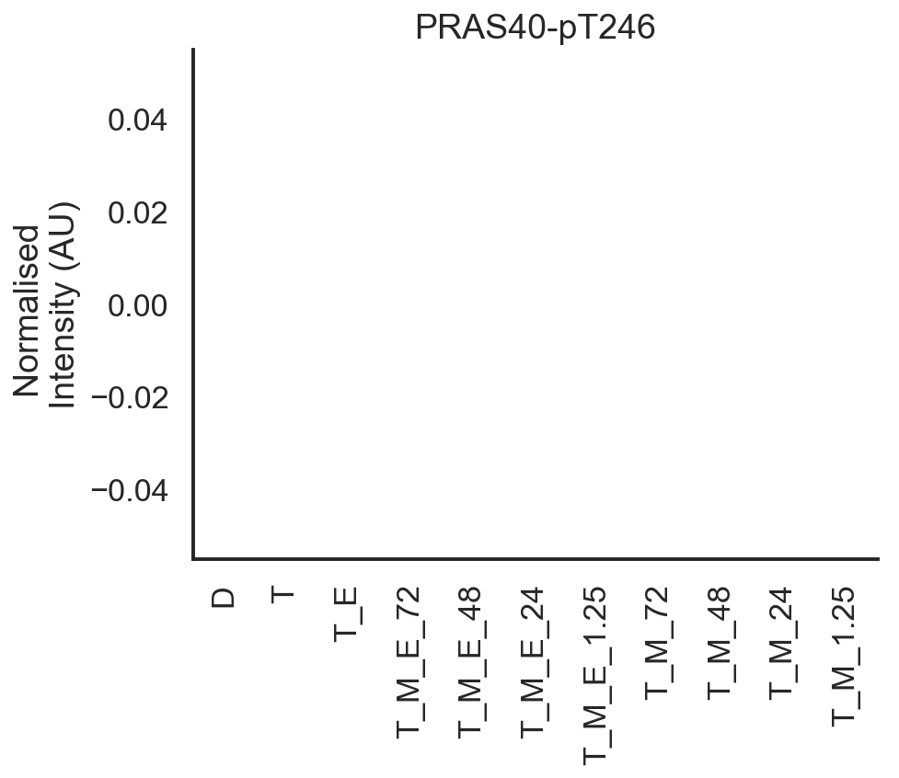
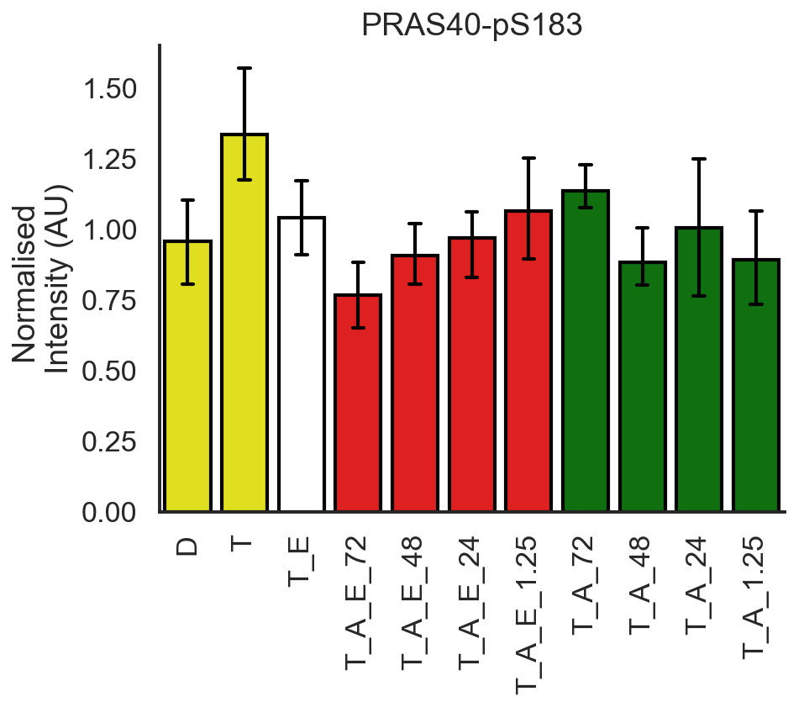
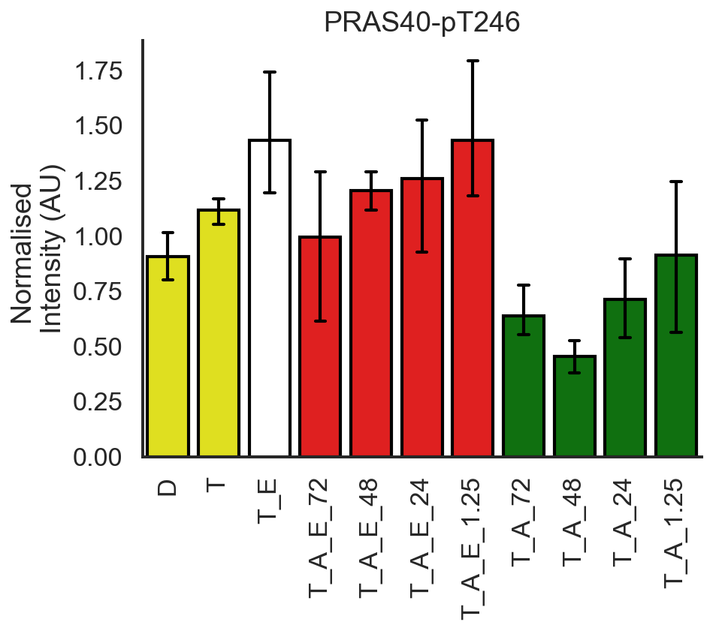
+ Everolimus
- Everolimus
MK Data
AZD Data
+ Everolimus
- Everolimus

Slide 2
Misconception about experiment design
Previously all conditions were being modelled with TGFb present at time 0
But experimentally, this is not the case
Right?
When I asked for TGFb depletion kinetics data last week I was under the impression that you treated with TGFb initially and then again at 71.25h.

Slide 3
Event based modelling
Will hopefully allow us to map the experimental protocol directly onto model
I don’t think the previous strategy of starting the simulation with the various initial conditions mapped the simulation variables correctly onto the experimental variables
Previously (as I recall), the simulation started with TGFb in all conditions whereas in reality, TGFb is only used at 71.25h after the first pretreatment.
Previously, we set the initial conditions and allowed the simulation to progress, using the 24, 48 and 72h as read out times. This neglects the stimulation part of the protocol (i.e. TGFb stimulation at t=71.25h = -45min)
An alternative strategy is to use events to reproduce the experimental protocol exactly

Slide 4
 |  |  | Time (h)
Sample Number | Condition Code | Condition | 0.00 | 24.00 | 48.00 | 70.25 | 70.75 | 71.25 | 72.00
1 | D | DMSO | Add DMSO | - | - | Starve | - | - | Lysis
2 | T | TGFb | Add DMSO | - | - | Starve | - | TGFb Treatment | Lysis
3 | T_E | TGFb + EV | Add DMSO and EV | - | - | Starve | - | TGFb Treatment | Lysis
4 | T_M_E_0 | TGFB + Everolimus+ MK 3 | Add EV and MK | - | - | Starve | - | TGFb Treatment | Lysis
5 | T_M_E_24 | TGFB + Everolimus+ MK2 | Add EV | Add MK | - | Starve | - | TGFb Treatment | Lysis
6 | T_M_E_48 | TGFB + Everolimus+ MK 1 | Add EV | - | Add MK | Starve | - | TGFb Treatment | Lysis
7 | T_M_E_70.75 | TGFB + Everolimus+ MK30 mins | Add EV | - | - | Starve | Add MK | TGFb Treatment | Lysis
8 | T_M_0 | TGFB + MK 3 | Add DMSO and MK | - | - | Starve | - | TGFb Treatment | Lysis
9 | T_M_24 | TGFB + MK 2 | Add DMSO | Add MK | - | Starve | - | TGFb Treatment | Lysis
10 | T_M_48 | TGFB + MK 1 | Add DMSO | - | Add MK | Starve | - | TGFb Treatment | Lysis
11 | T_M_70.75 | TGFB + MK 30mins | Add DMSO | - | - | Starve | Add MK | TGFb Treatment | Lysis
 |  |  | Time (h)
Sample Number | Condition Code | Condition | 0.00 | 24.00 | 48.00 | 70.25 | 70.75 | 71.25 | 72.00
1 | D | DMSO | Add DMSO | - | - | Starve | - | - | Lysis
2 | T | TGFb | Add DMSO | - | - | Starve | - | TGFb Treatment | Lysis
3 | T_E | TGFb + EV | Add DMSO and EV | - | - | Starve | - | TGFb Treatment | Lysis
12 | T_A_E_0 | TGFB + Everolimus+AZD 3 | Add EV and AZD | - | - | Starve | - | TGFb Treatment | Lysis
13 | T_A_E_24 | TGFB + Everolimus+ AZD2 | Add EV | Add AZD | - | Starve | - | TGFb Treatment | Lysis
14 | T_A_E_48 | TGFB + Everolimus+ AZD 1 | Add EV | - | Add AZD | Starve | - | TGFb Treatment | Lysis
15 | T_A_E_70.75 | TGFB + Everolimus+ AZD30 mins | Add EV | - | - | Starve | Add AZD | TGFb Treatment | Lysis
16 | T_A_0 | TGFB + AZD 3 | Add DMSO and AZD | - | - | Starve | - | TGFb Treatment | Lysis
17 | T_A_24 | TGFB + AZD 2 | Add DMSO | Add AZD | - | Starve | - | TGFb Treatment | Lysis
18 | T_A_48 | TGFB + AZD 1 | Add DMSO | - | Add AZD | Starve | - | TGFb Treatment | Lysis
19 | T_A_70.75 | TGFB + AZD 30mins | Add DMSO | - | - | Starve | Add AZD | TGFb Treatment | Lysis

Slide 5
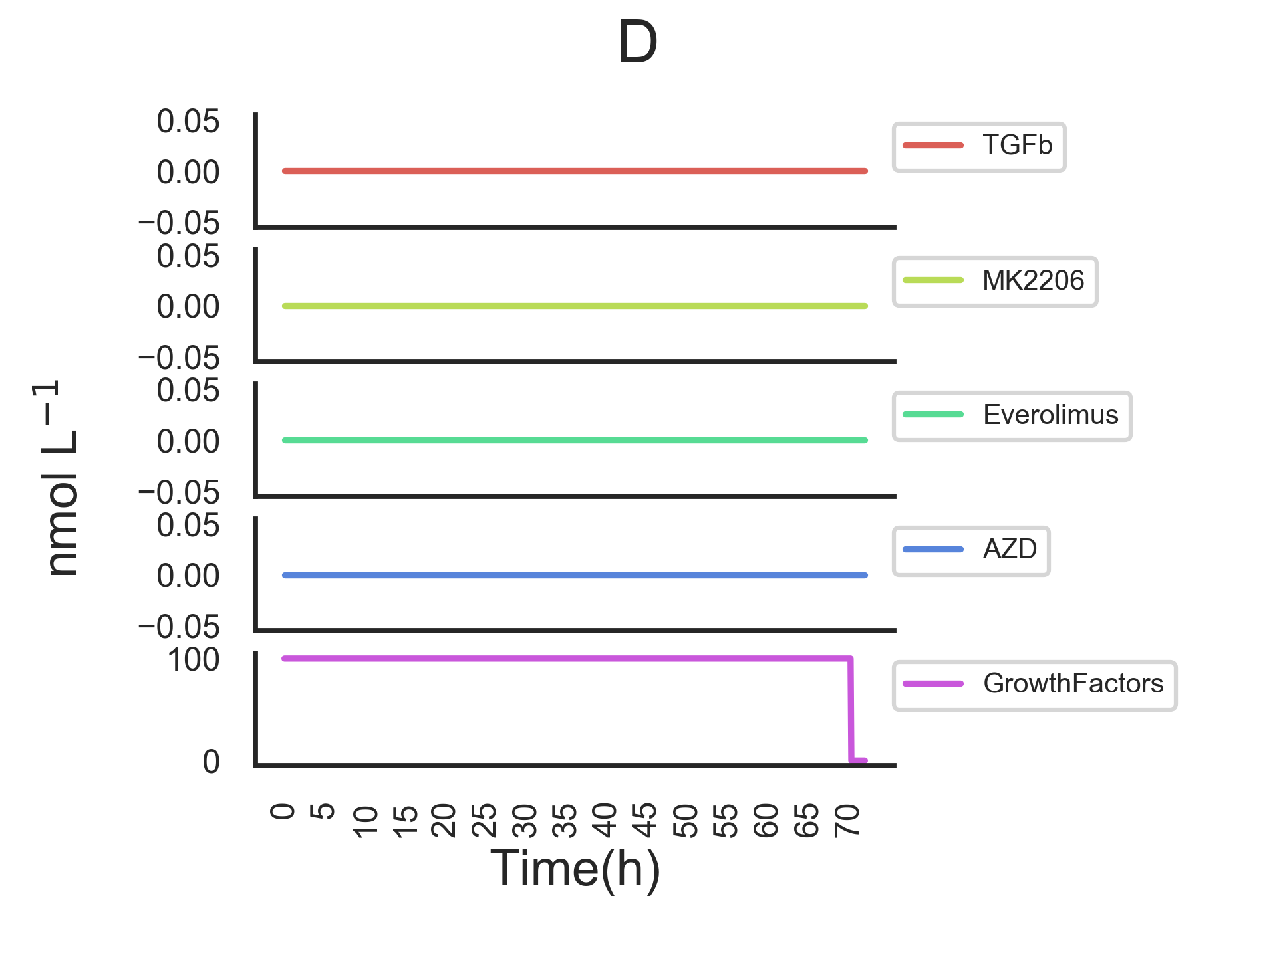
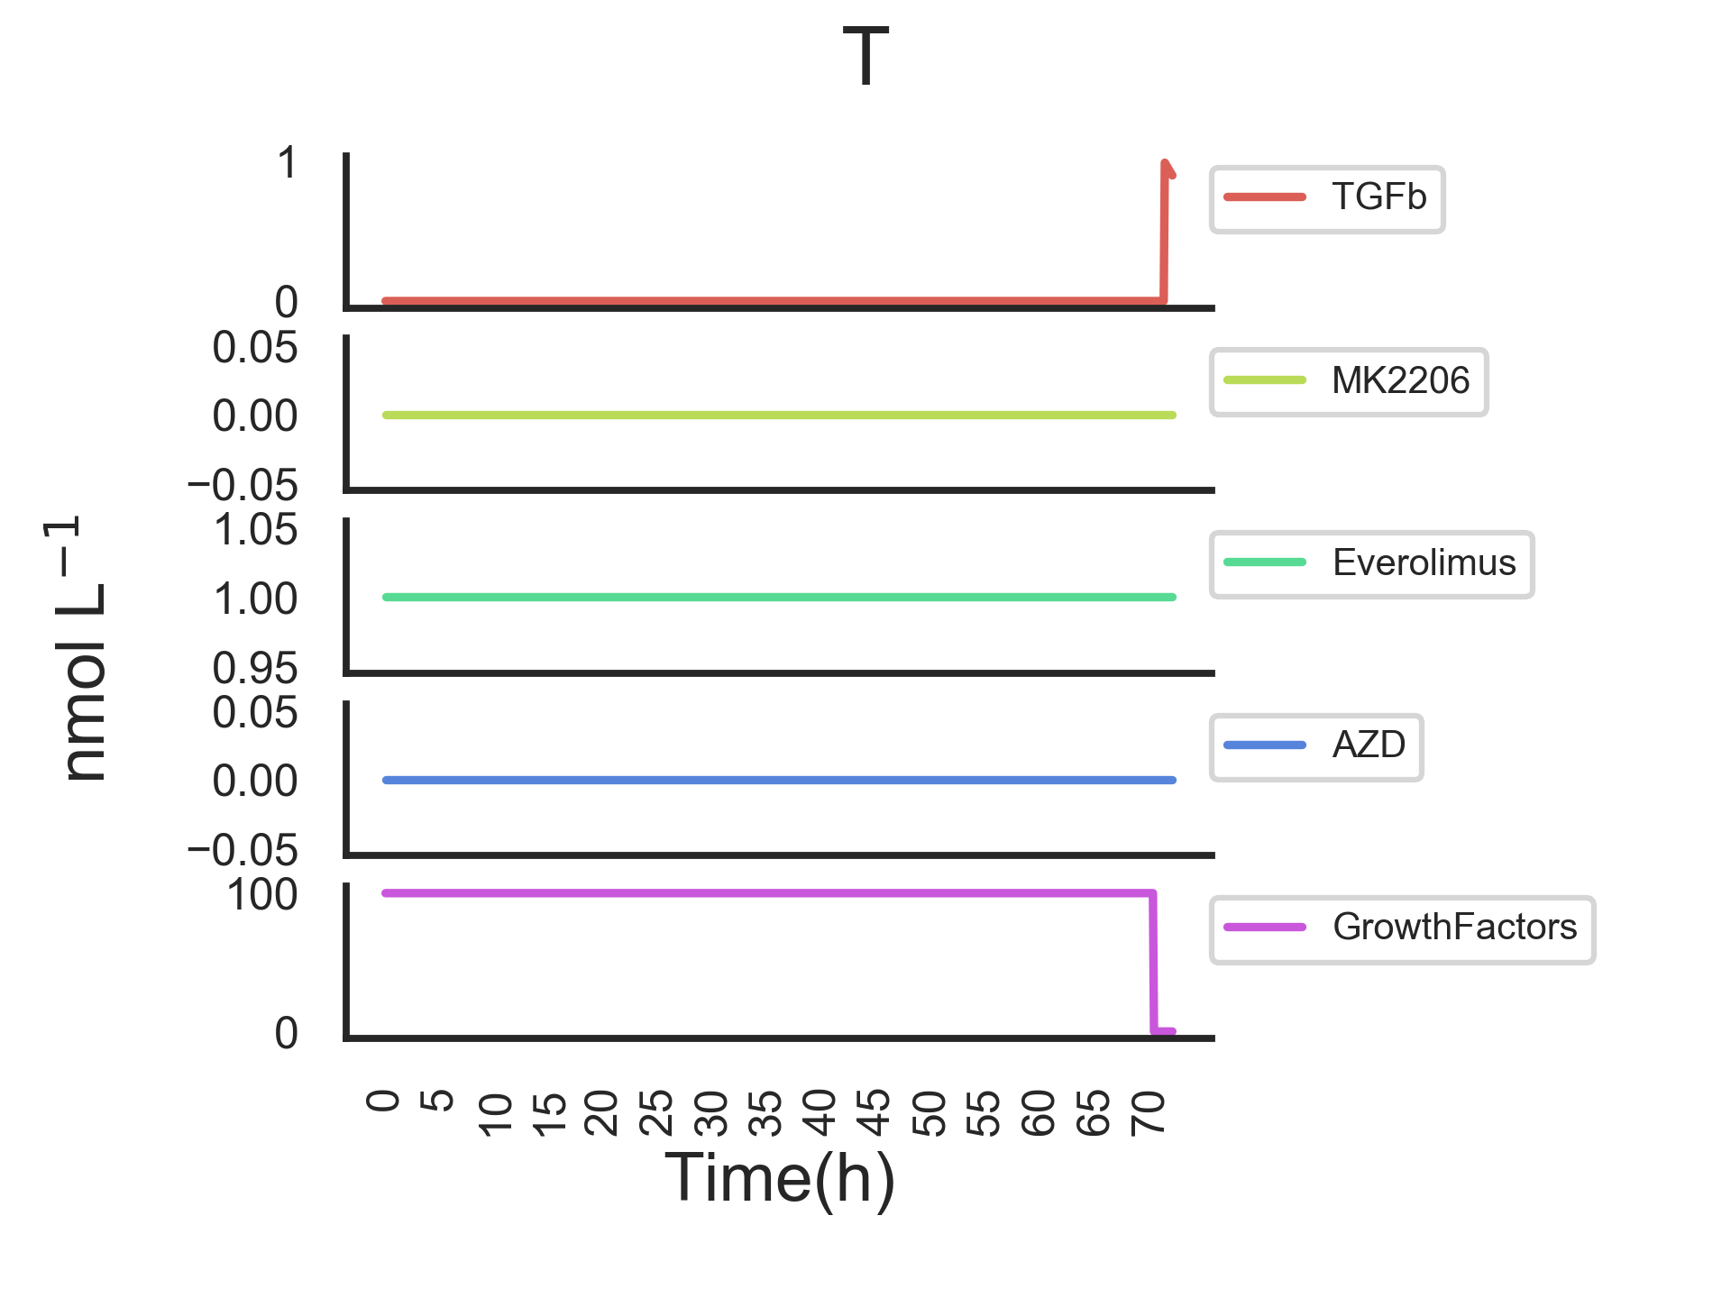
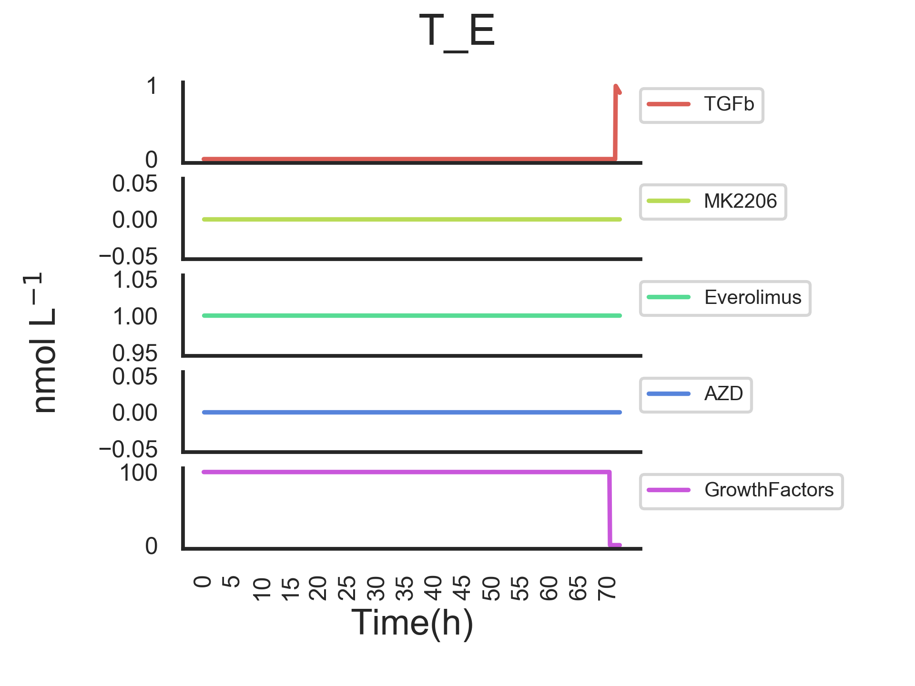

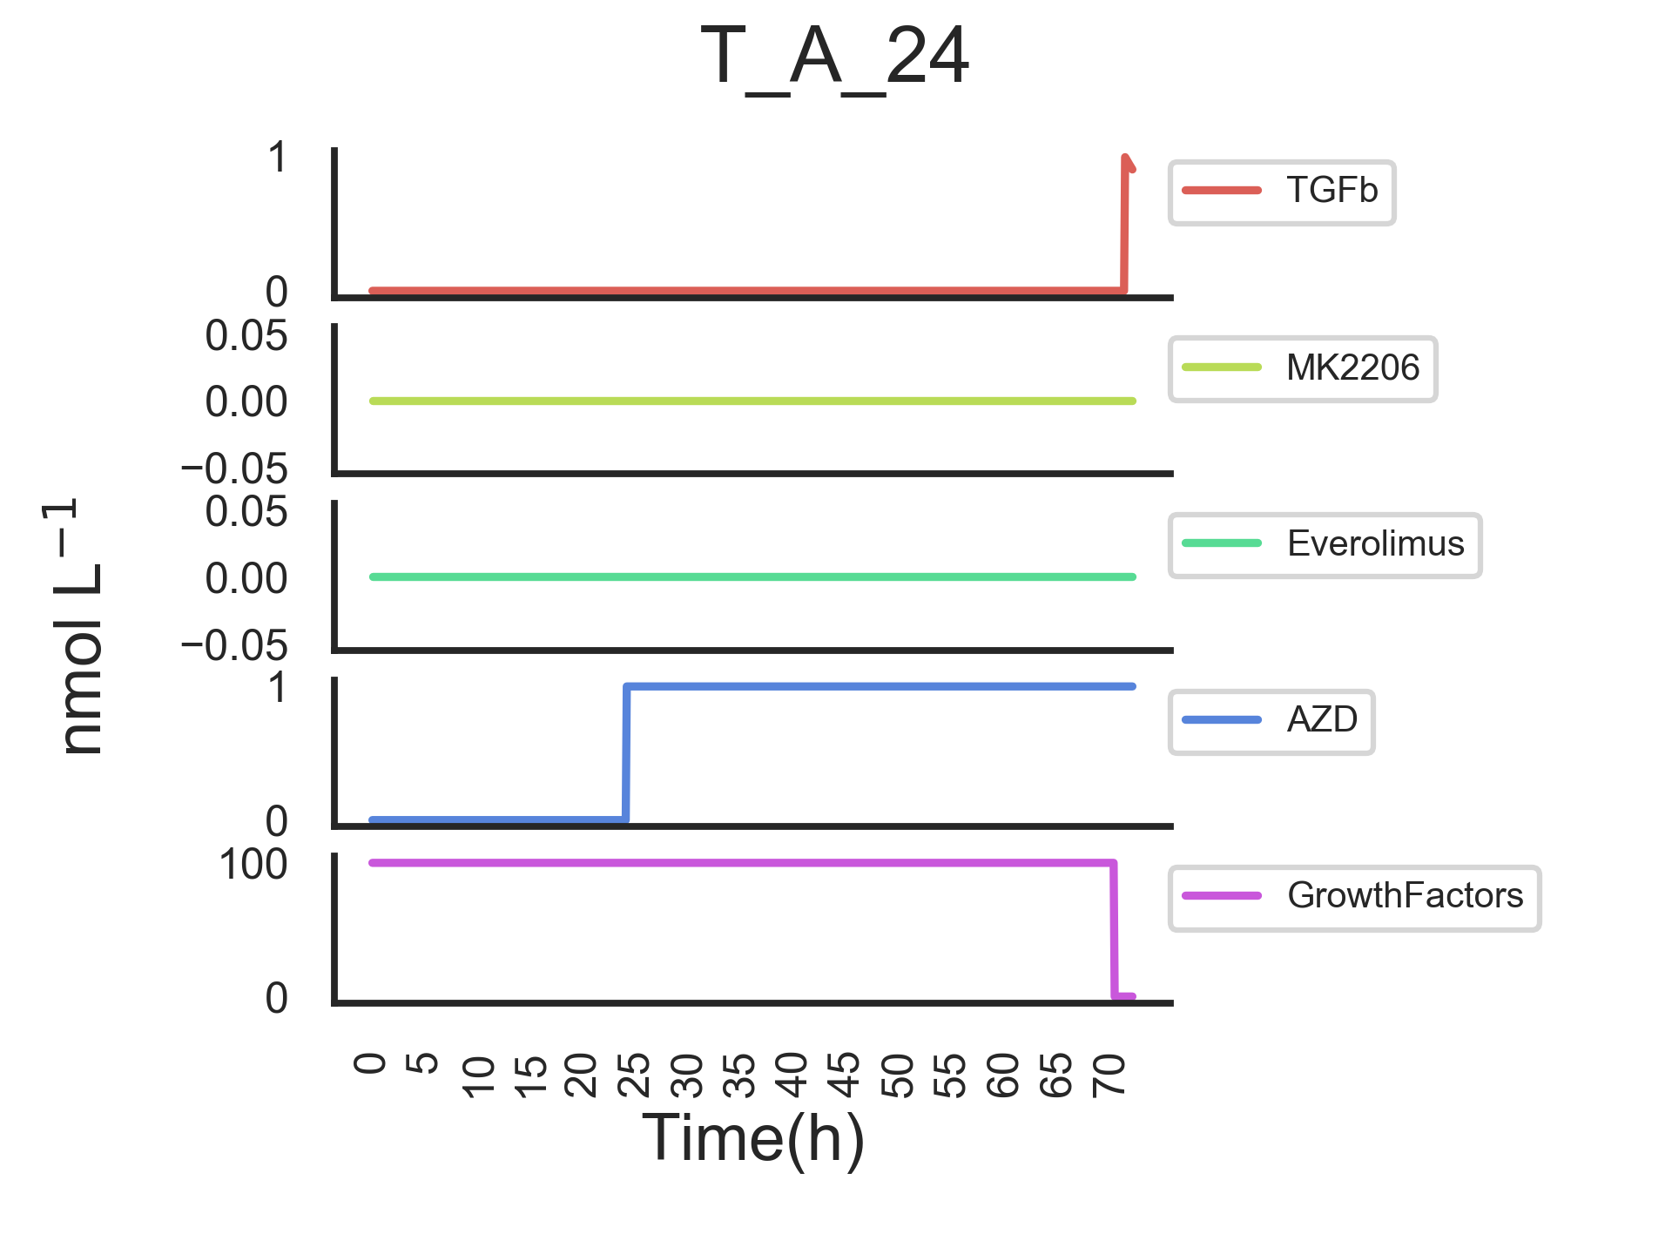
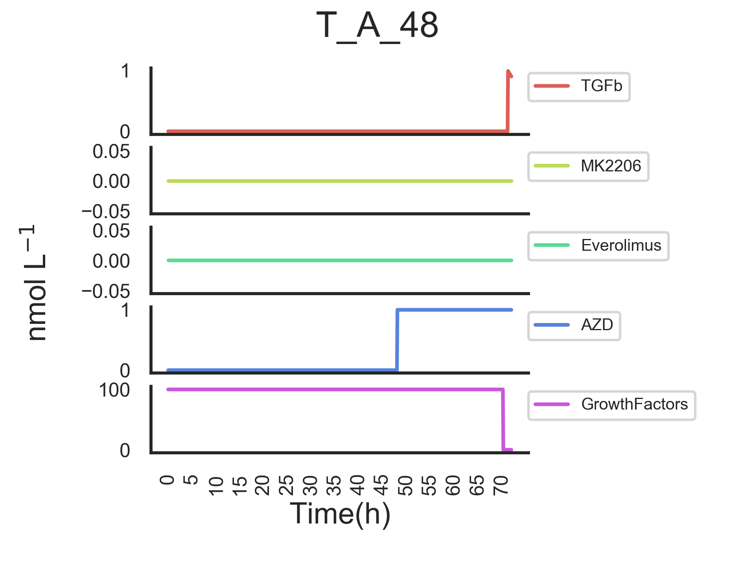
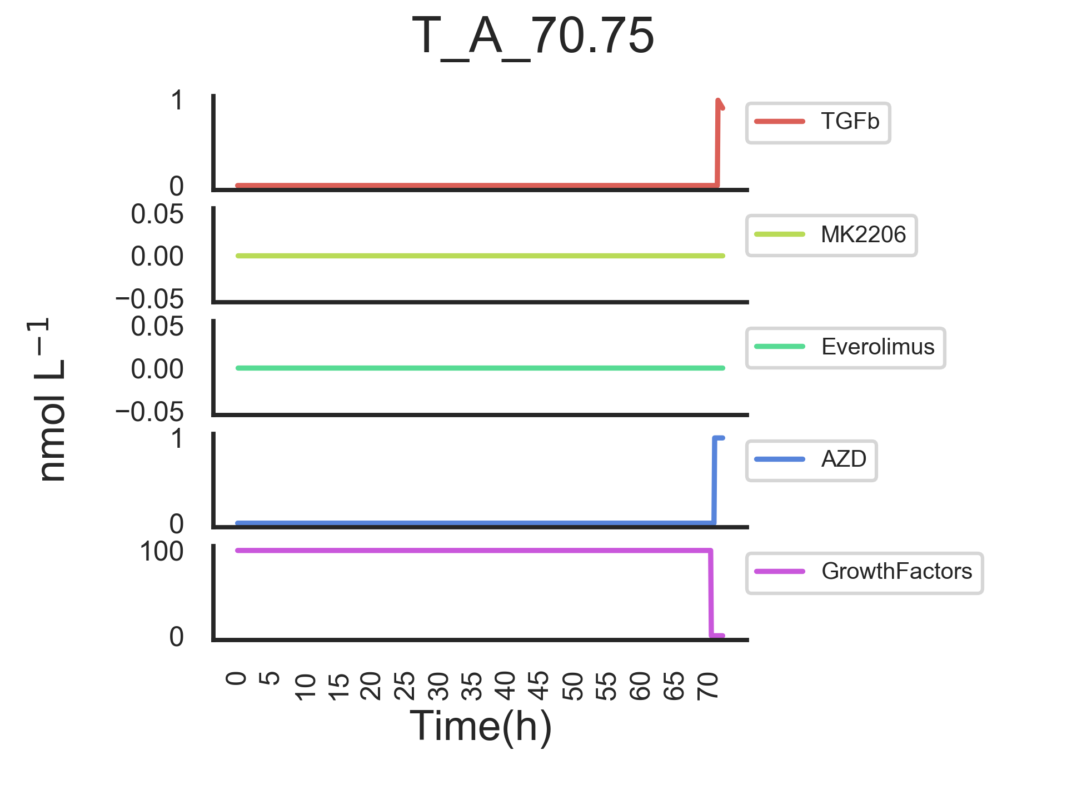
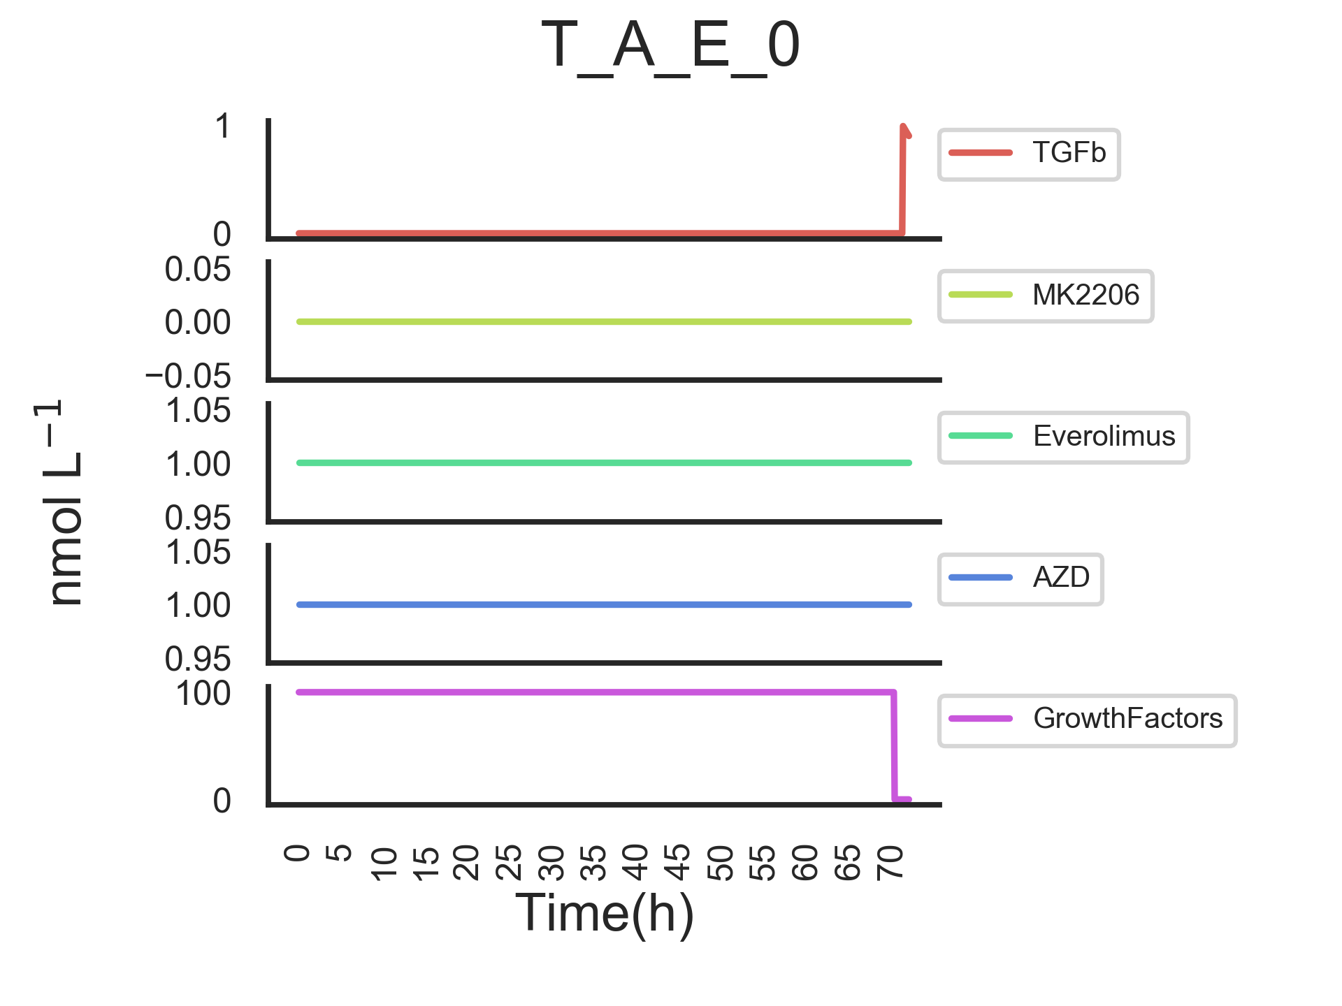

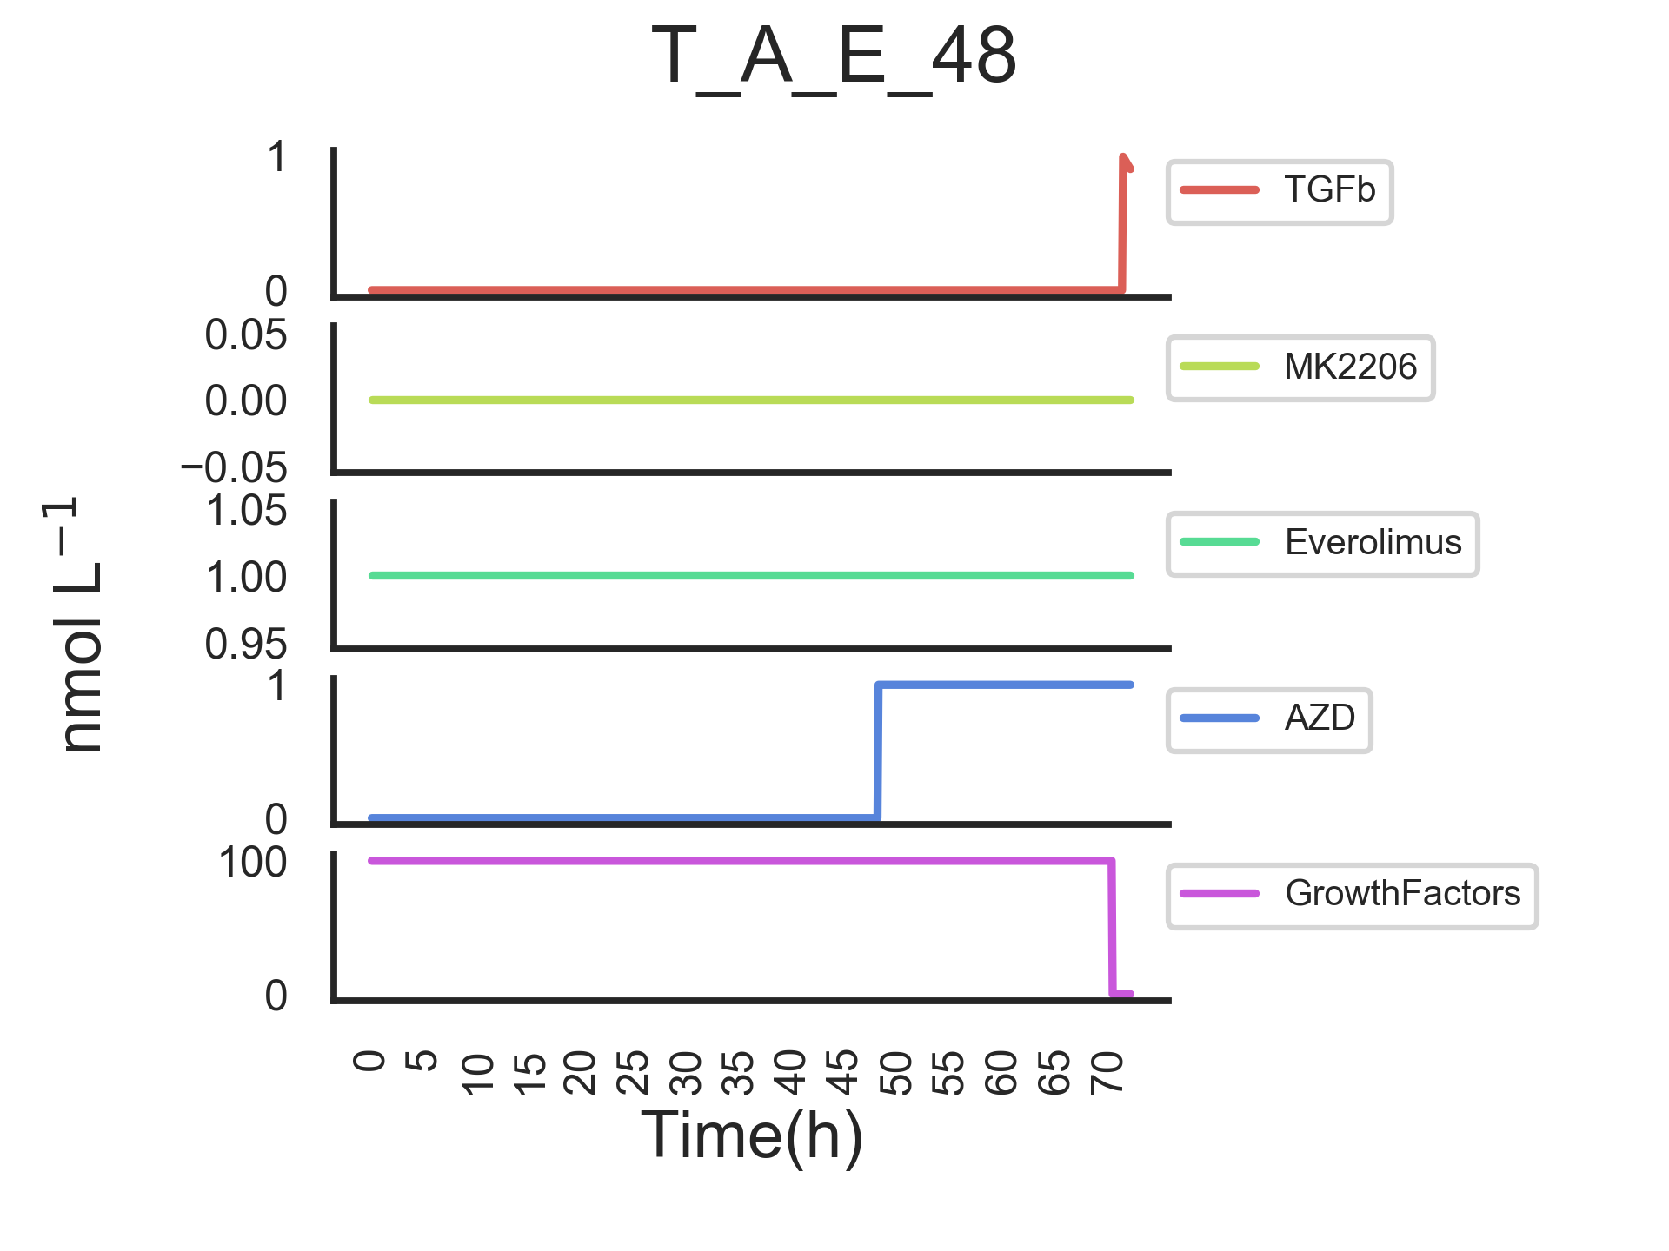
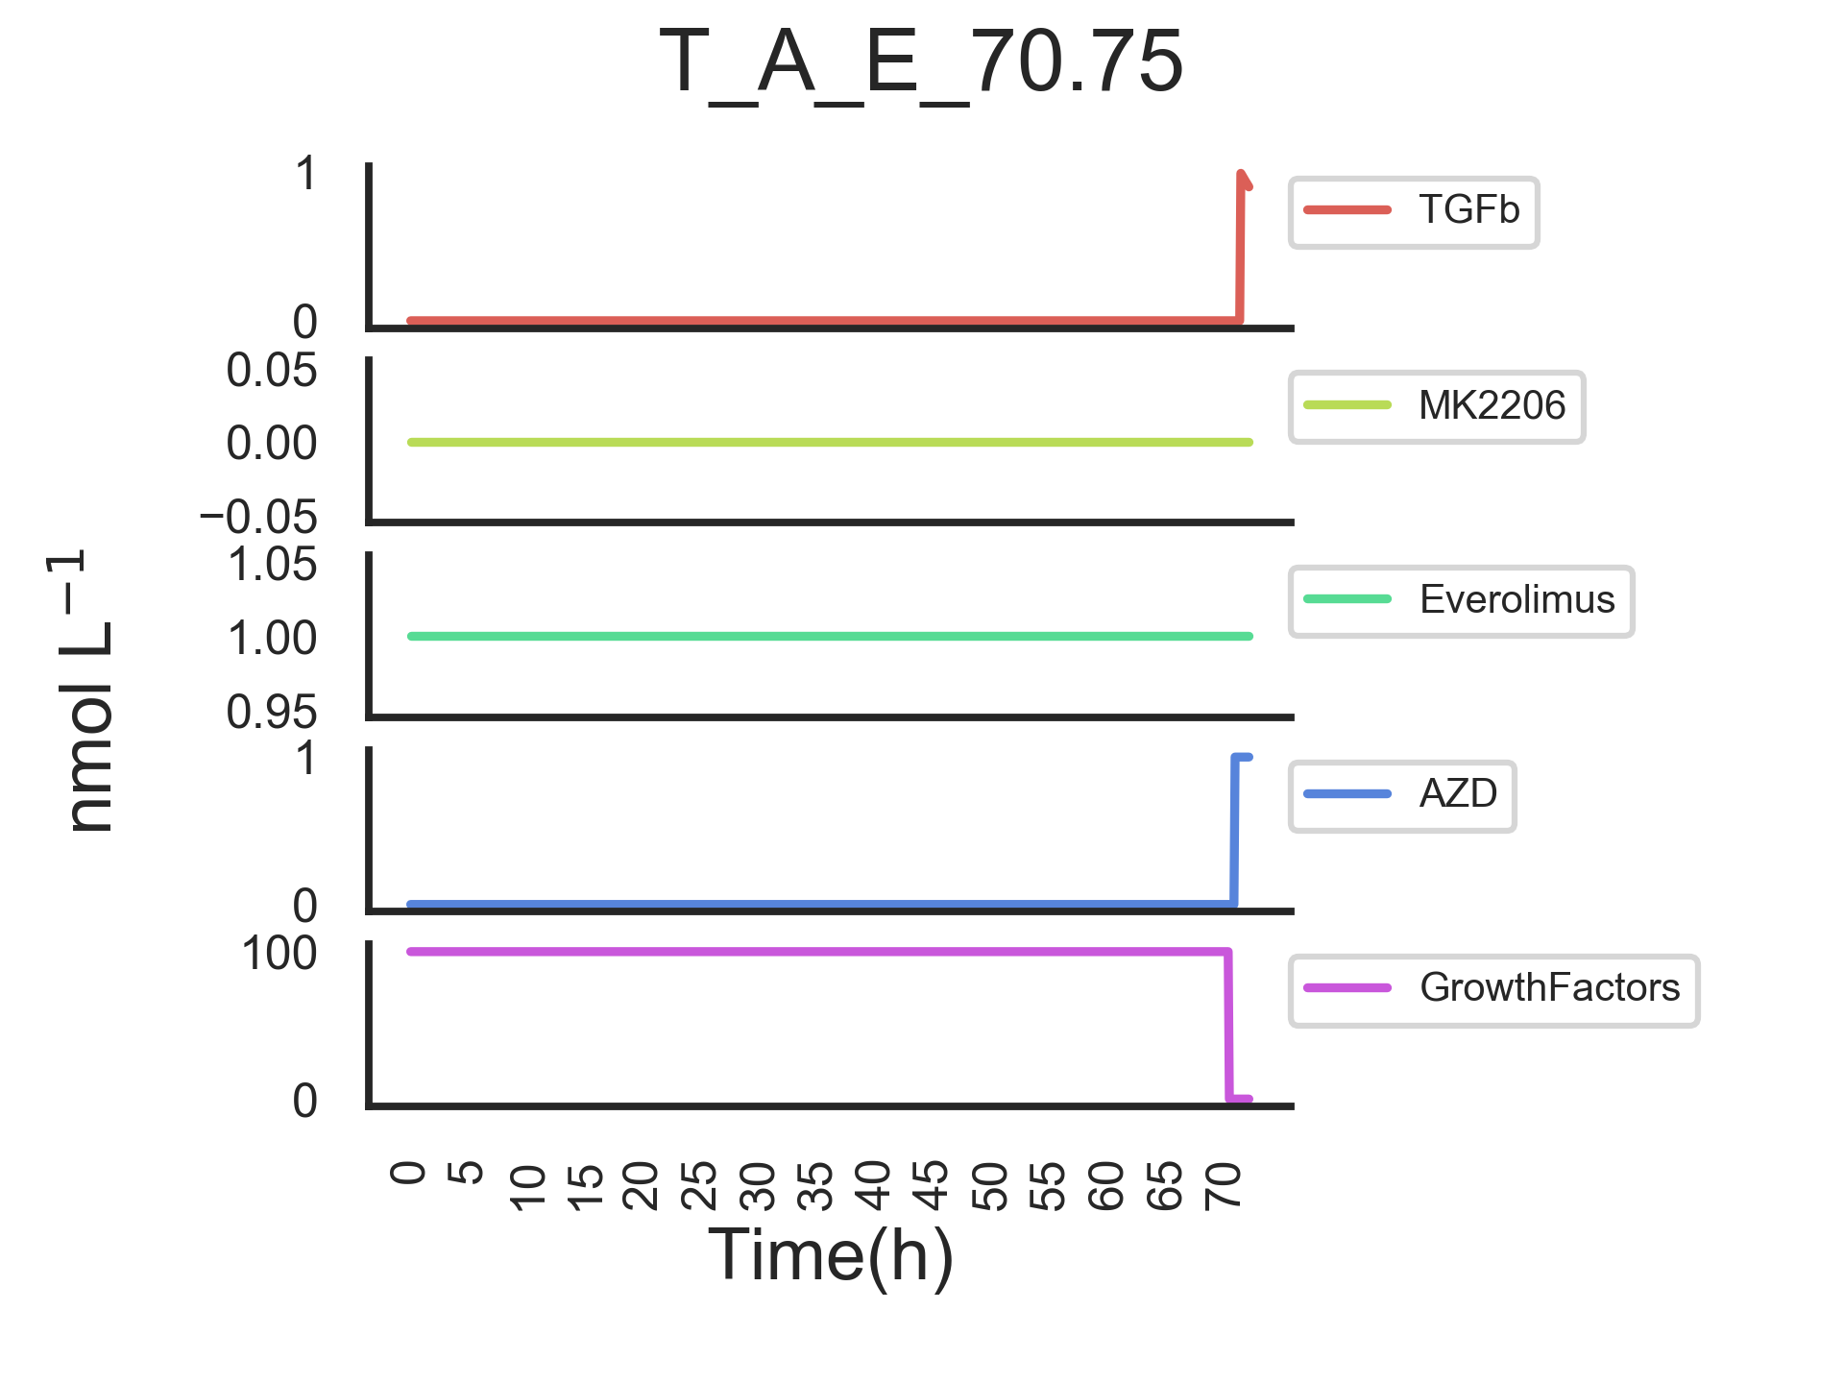
Modelling inputs
And similarly for MK2206 treatment. These inputs allow us to model the experiment as it was carried out.

Slide 6
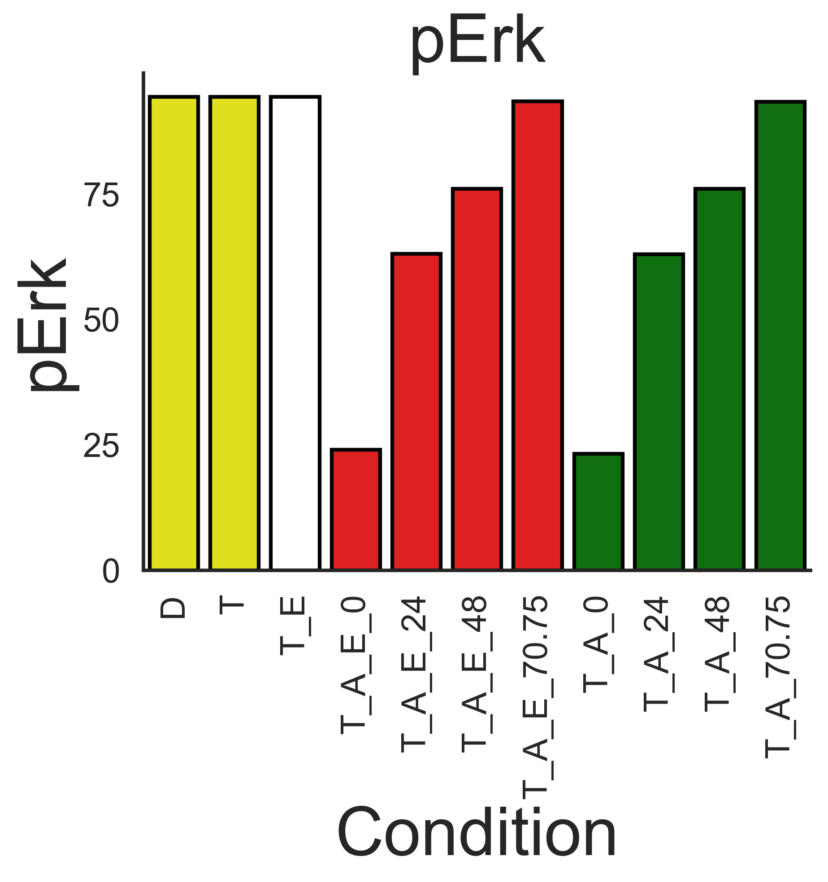
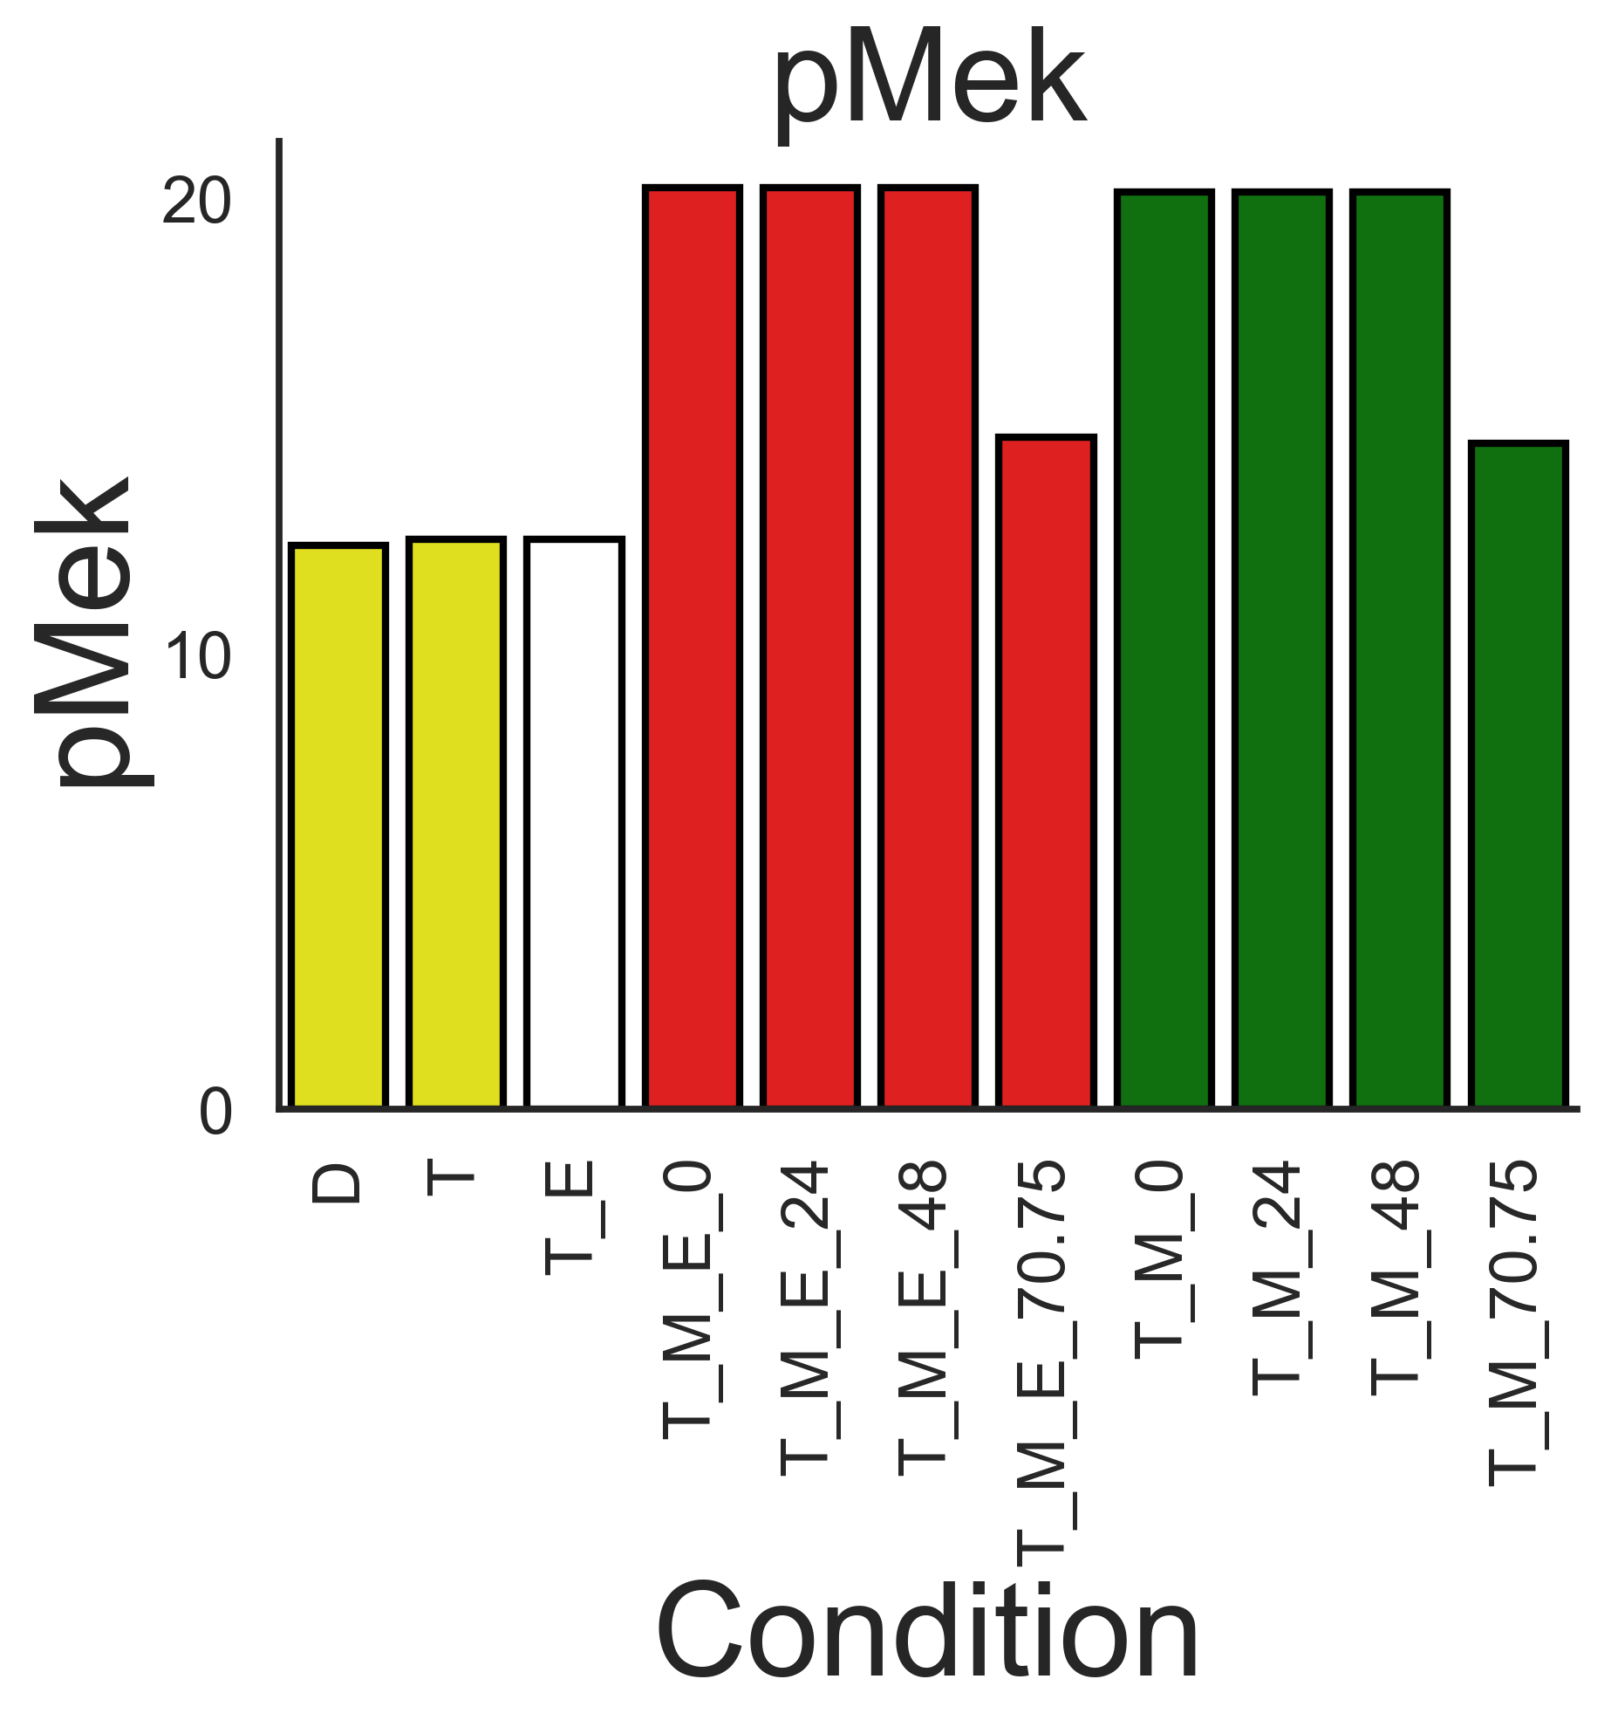
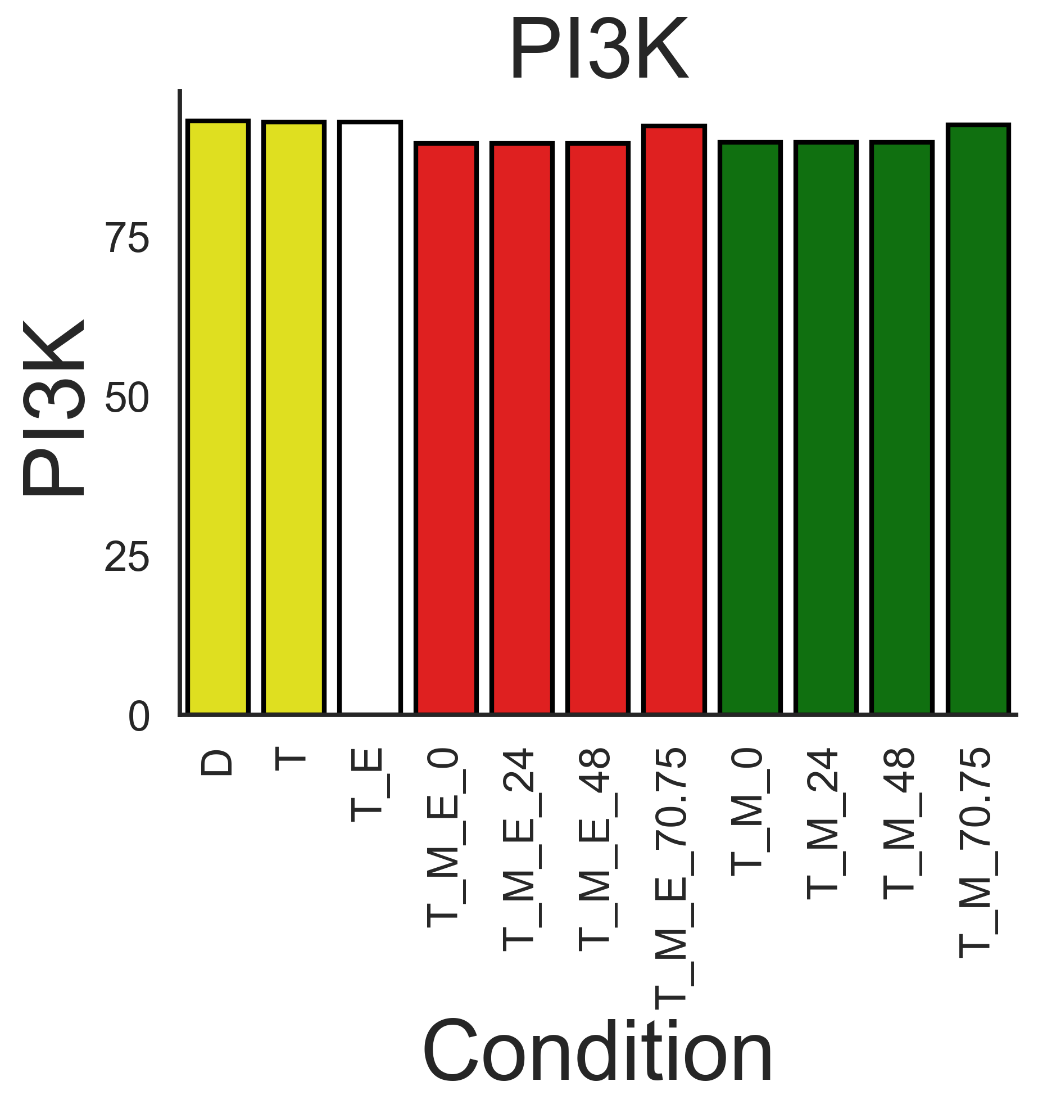
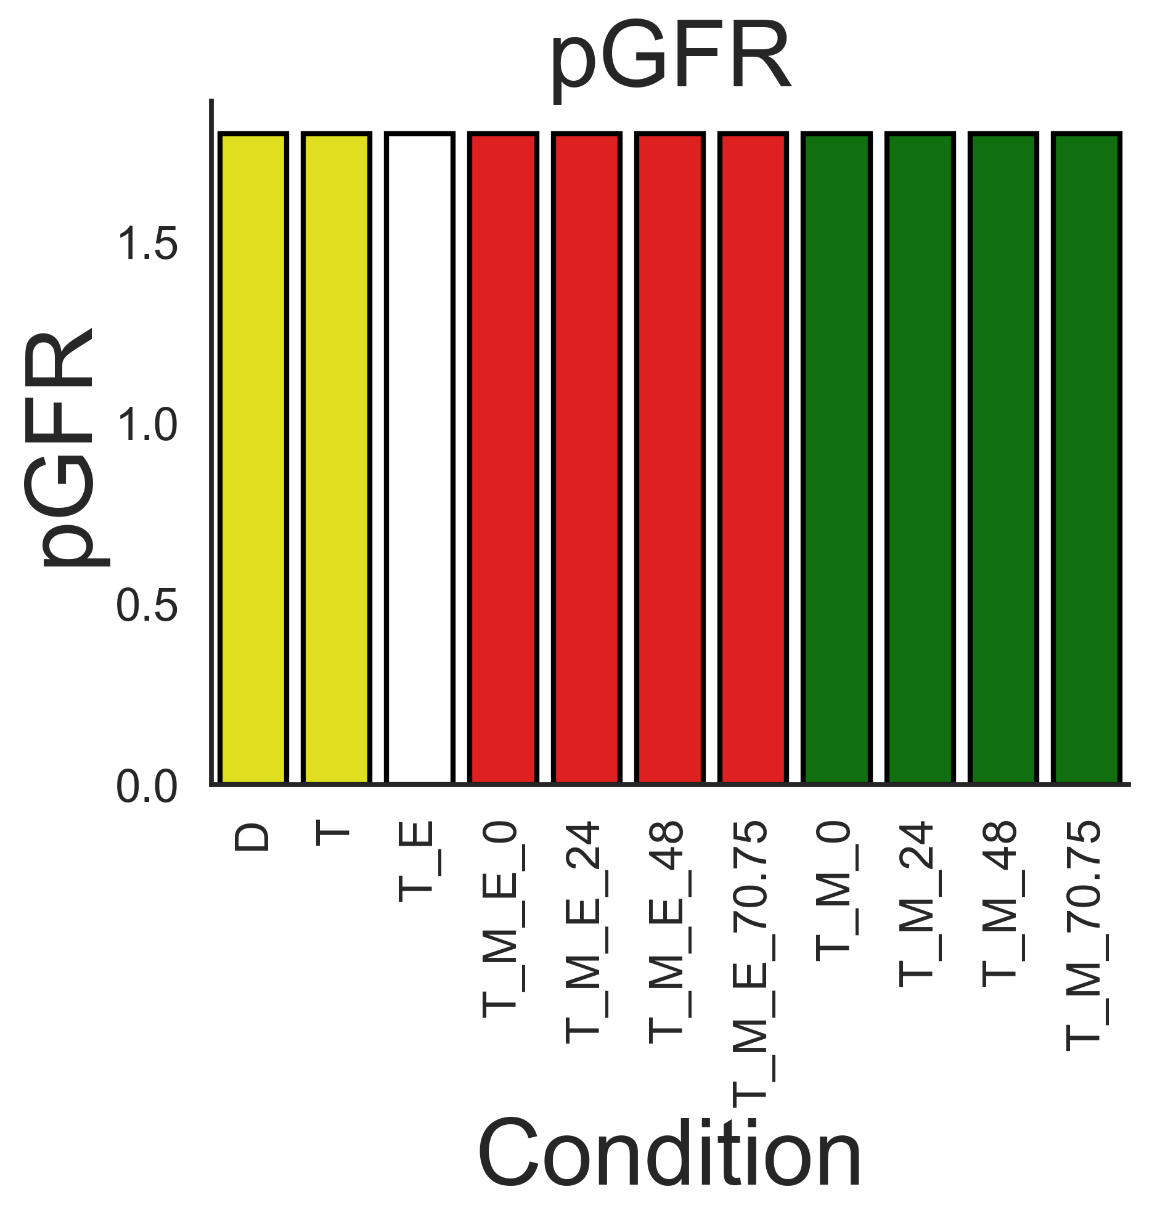
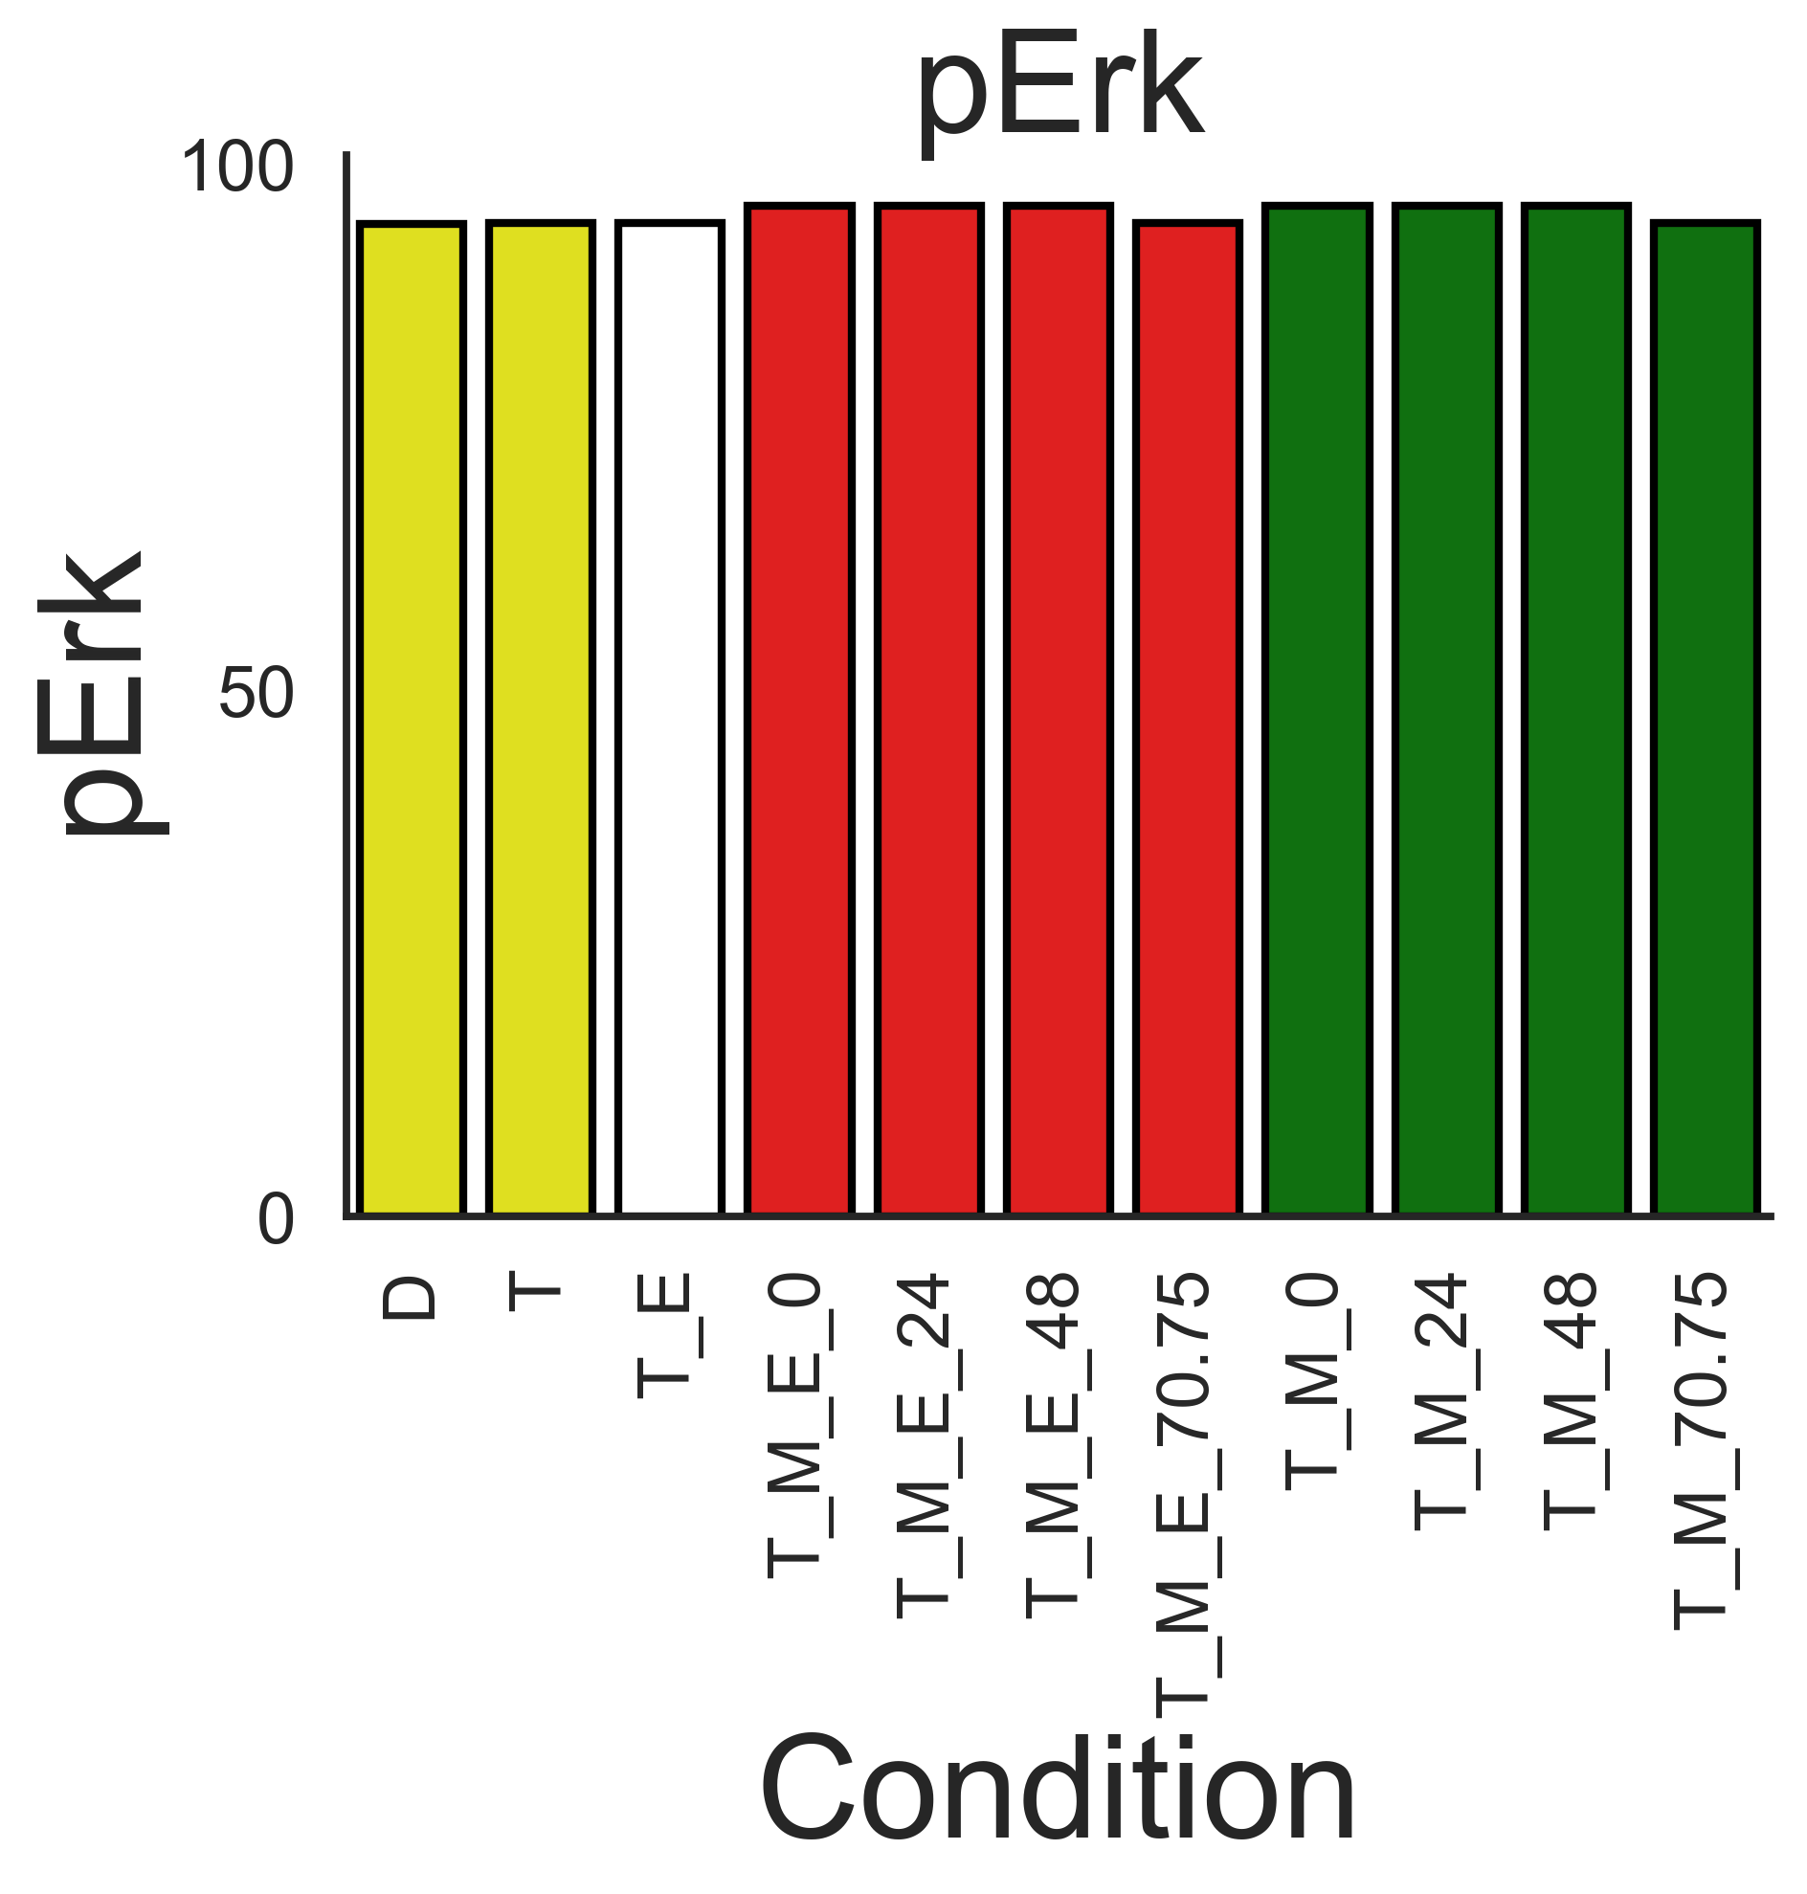
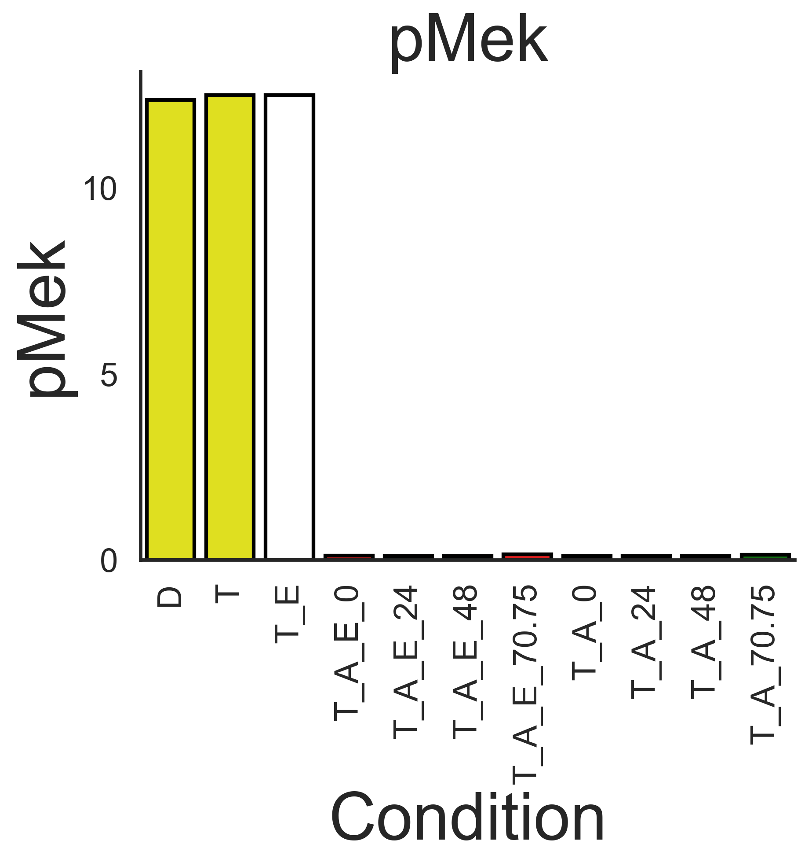
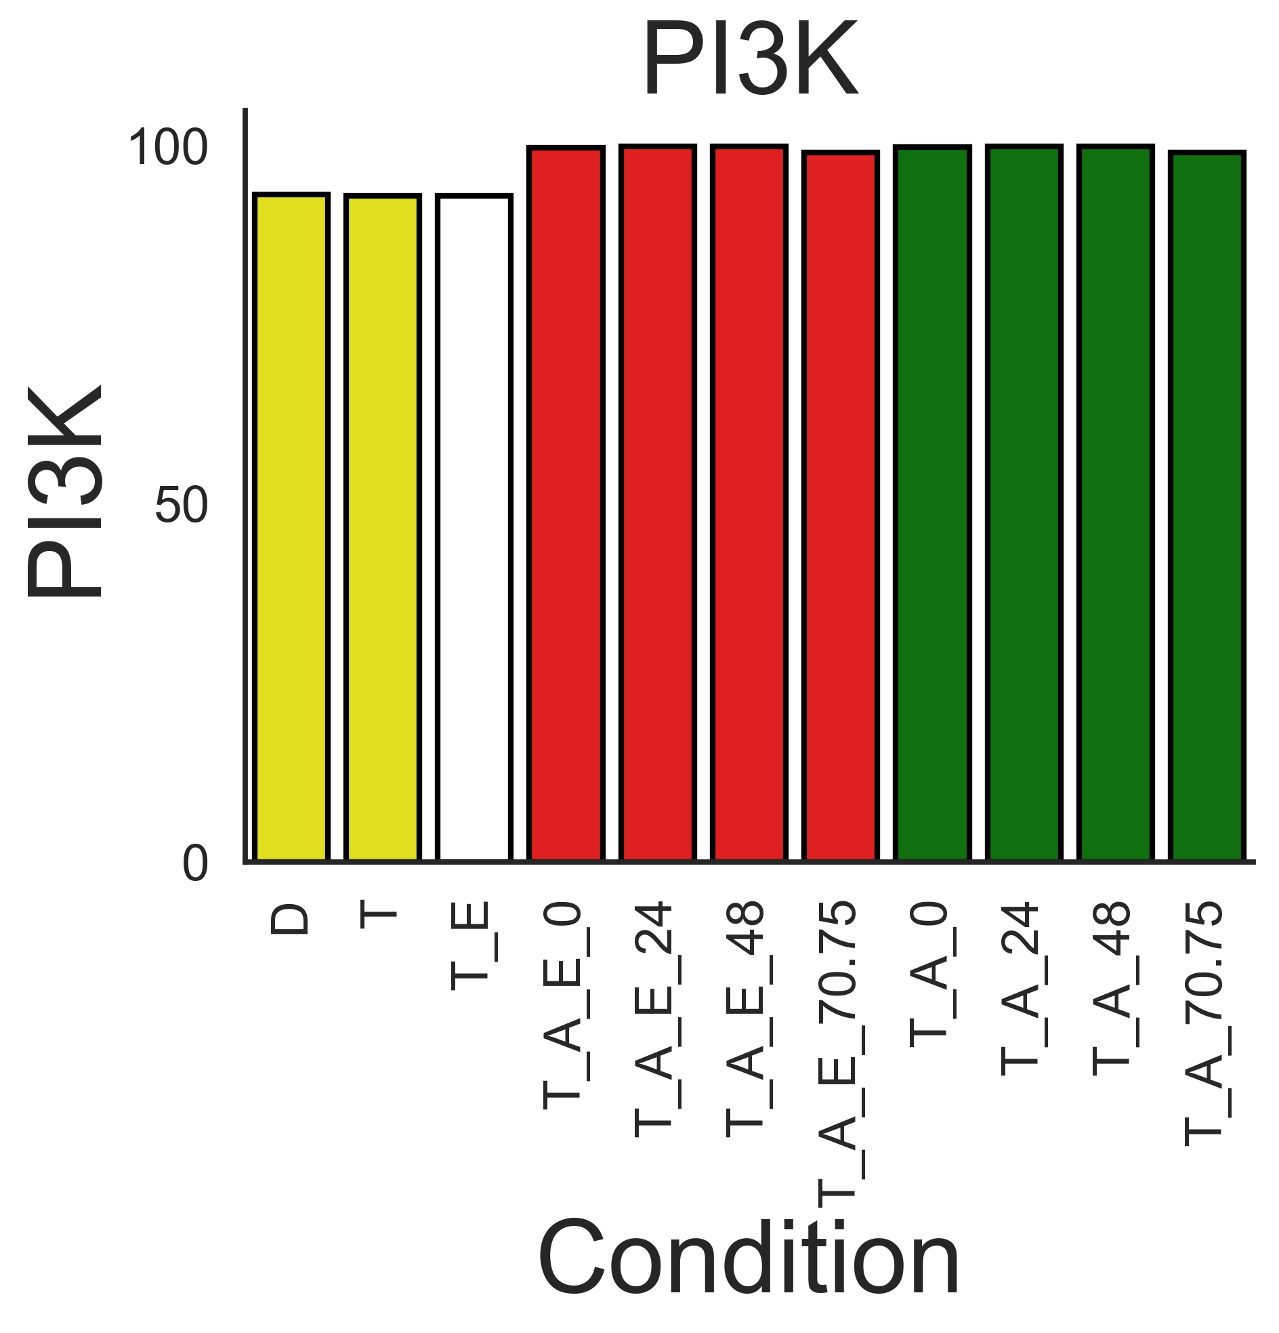

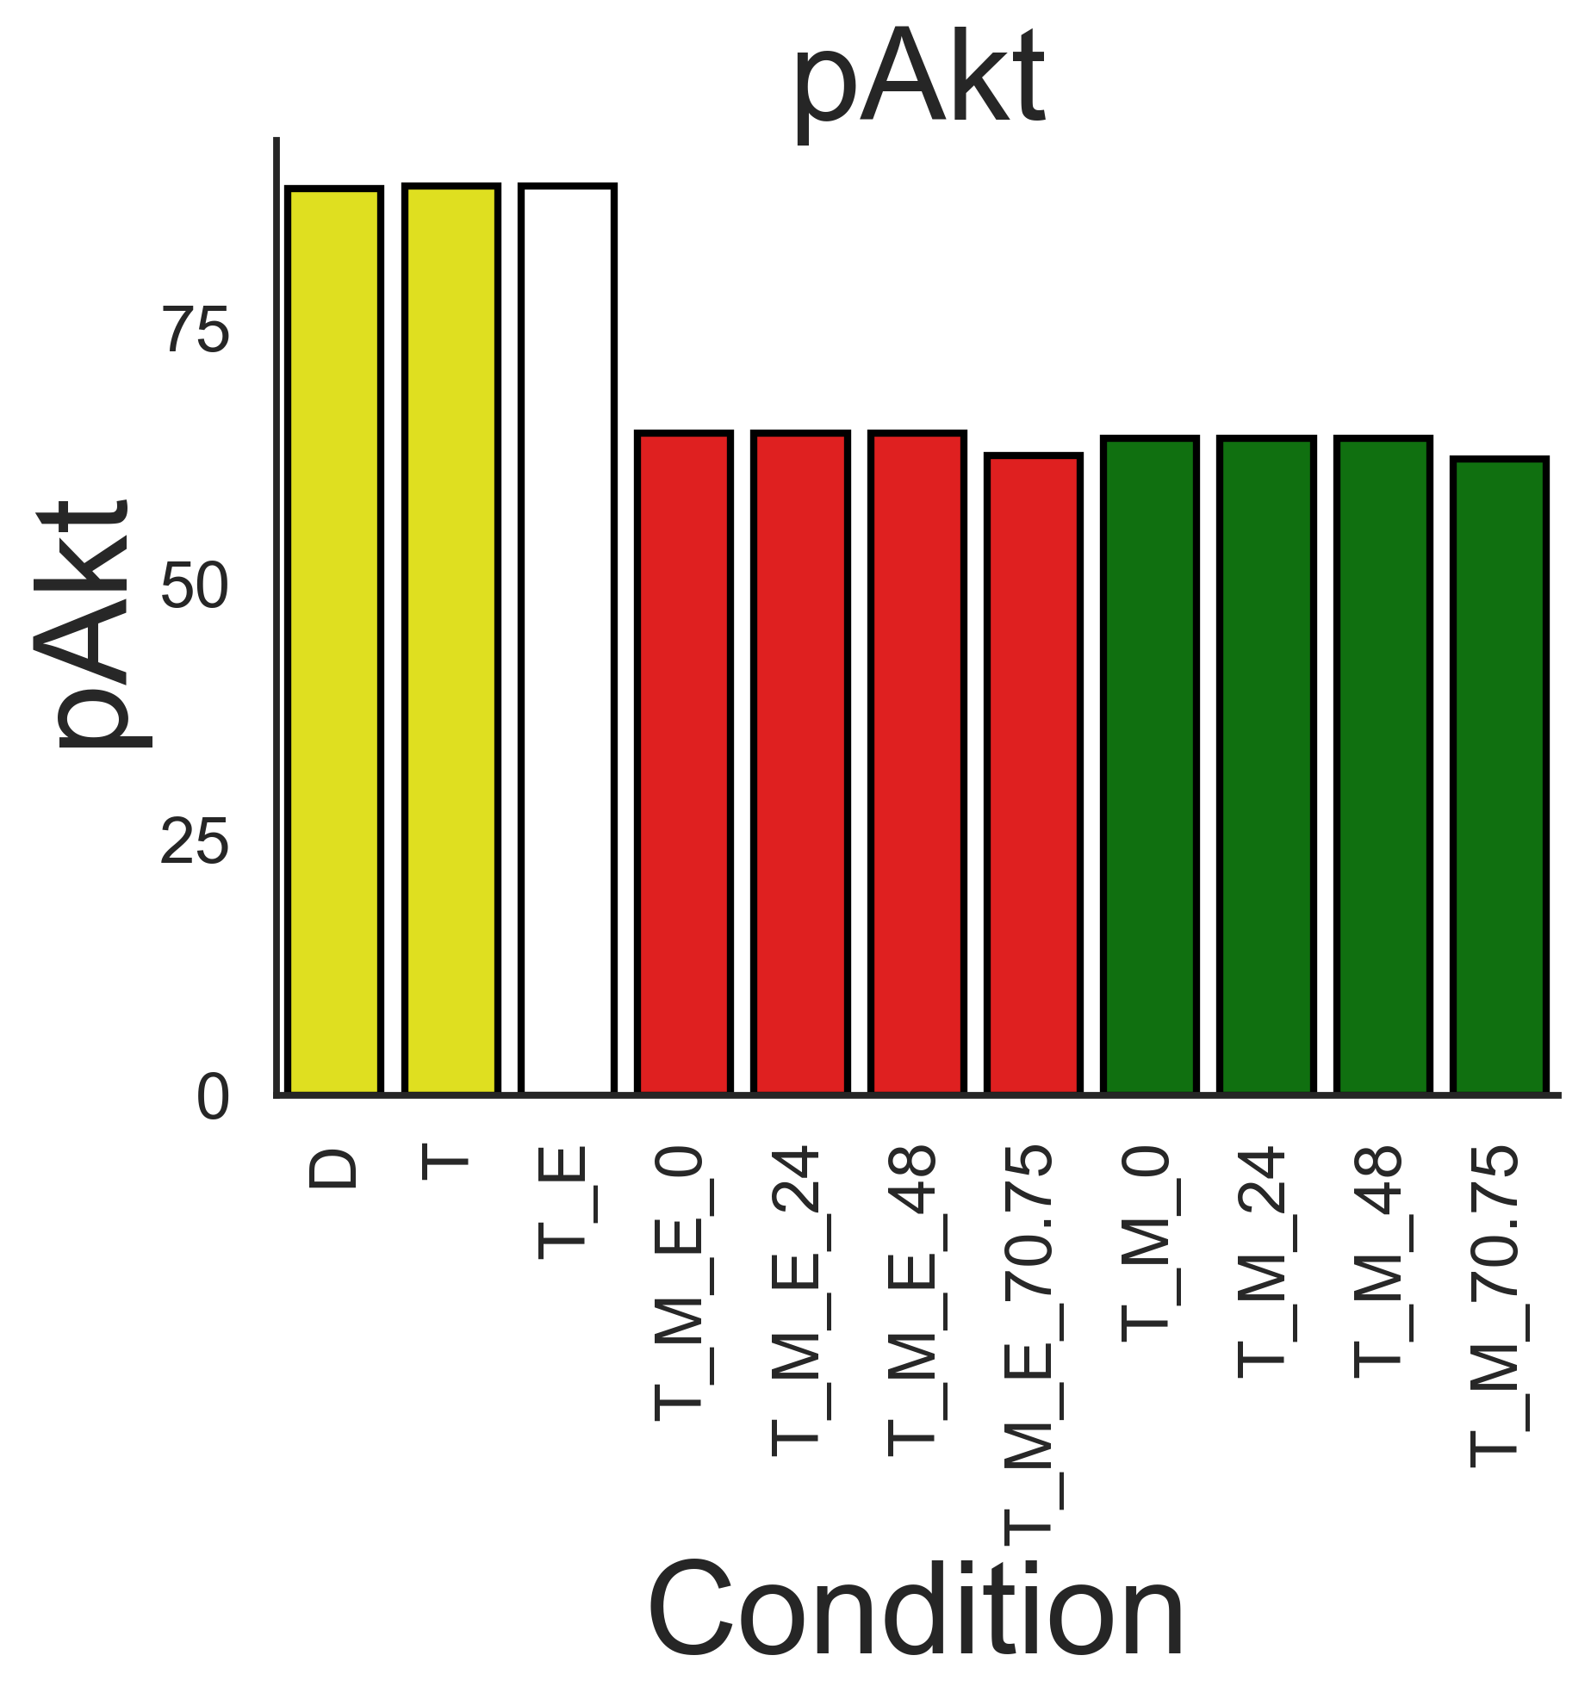
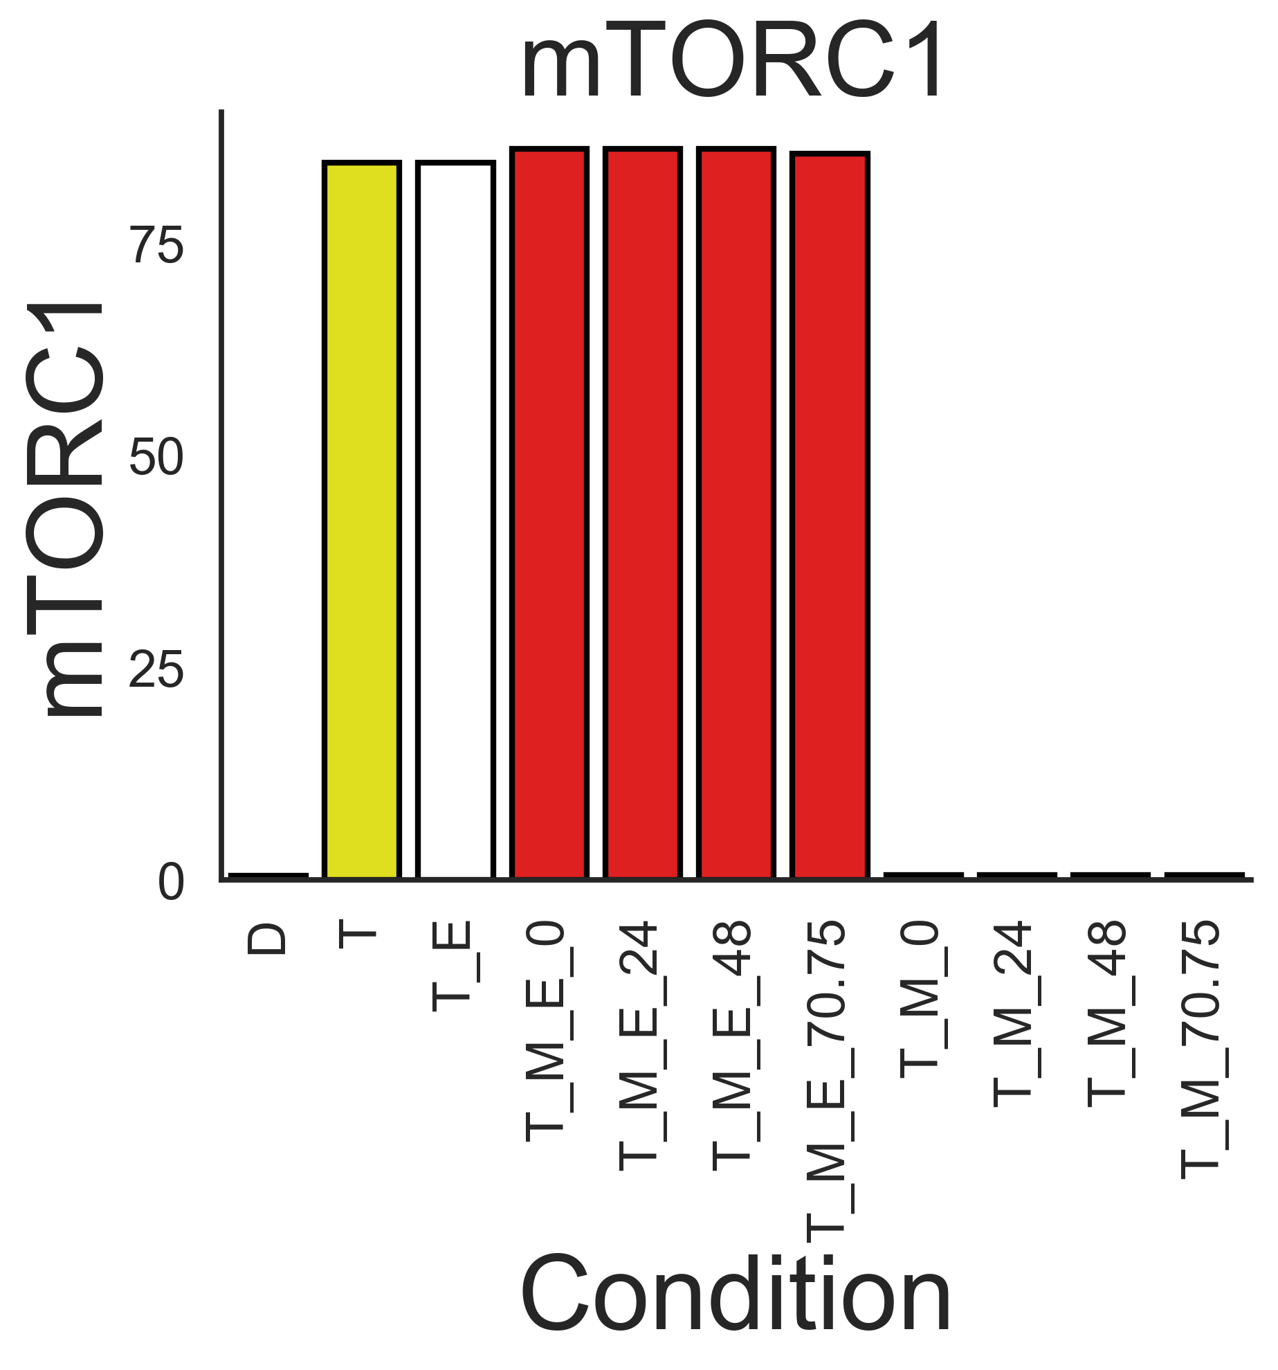
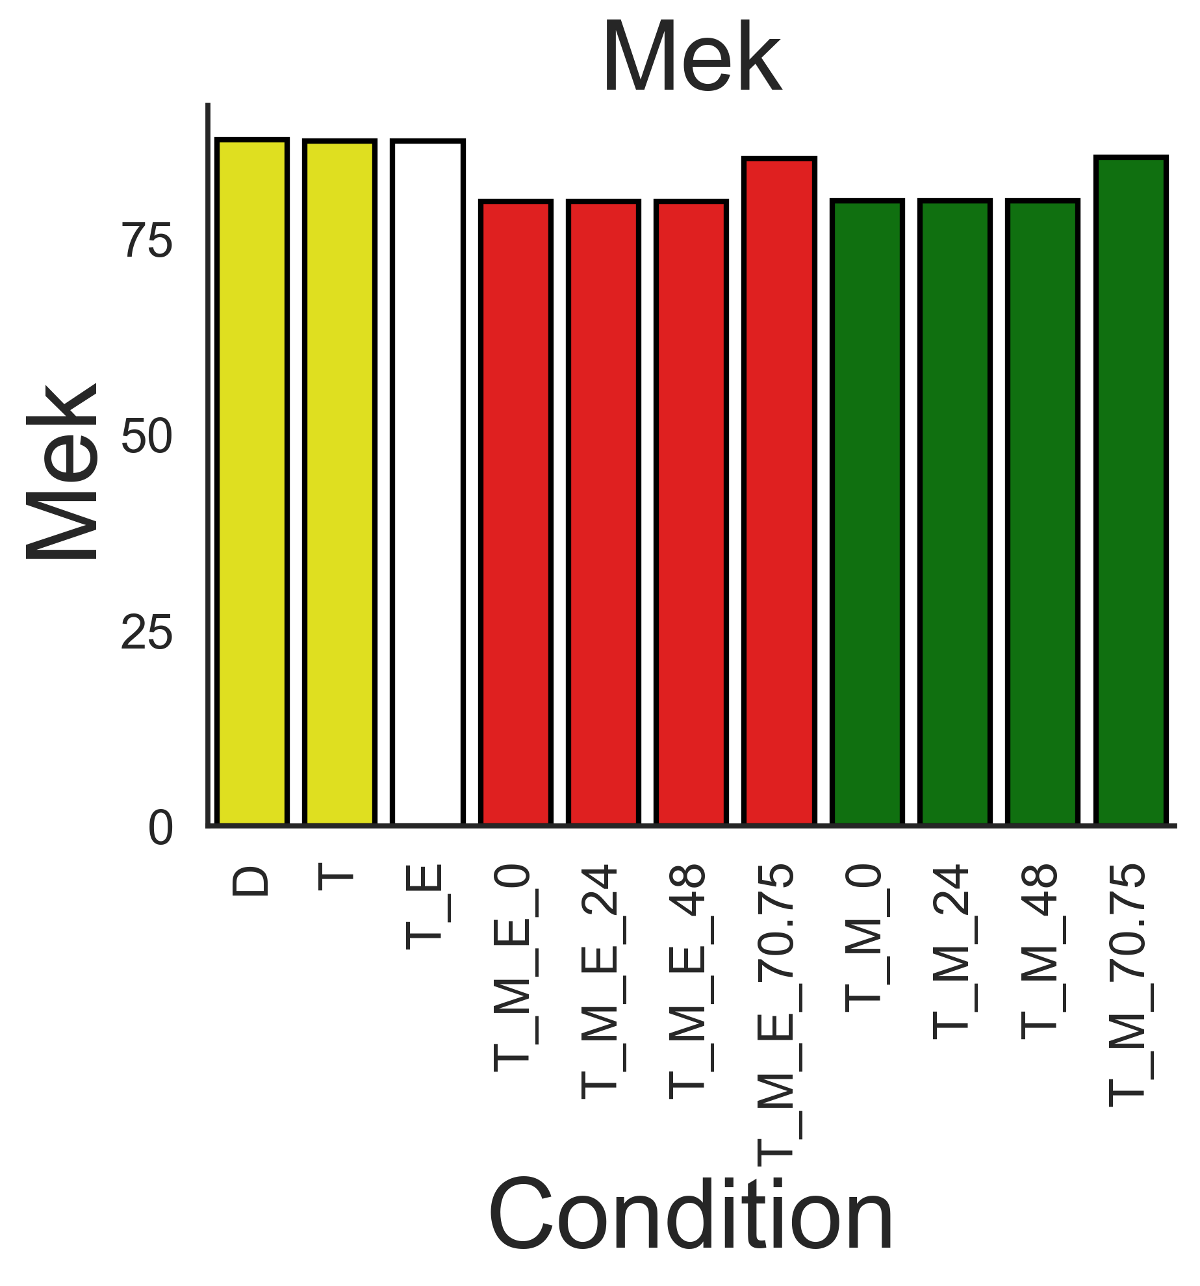
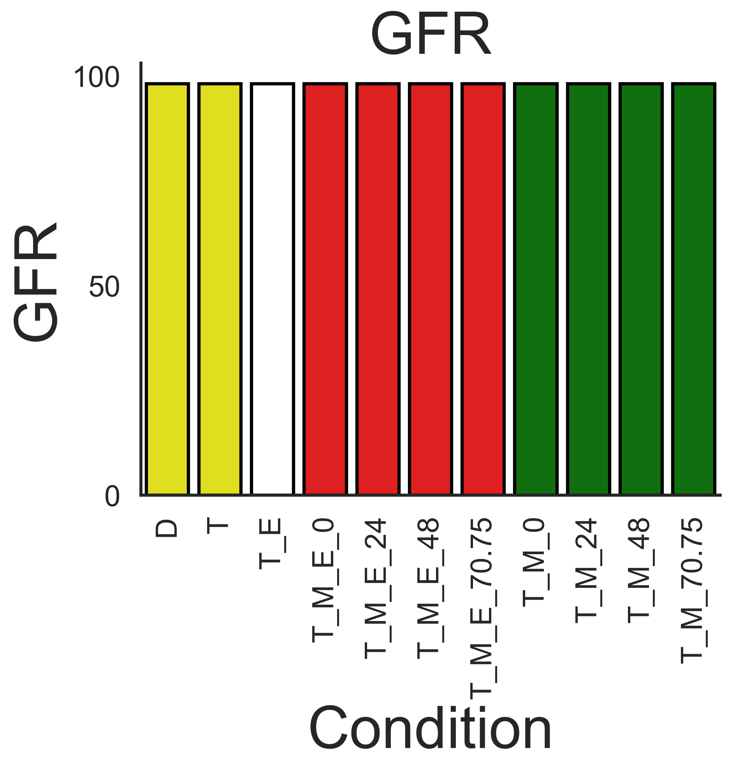
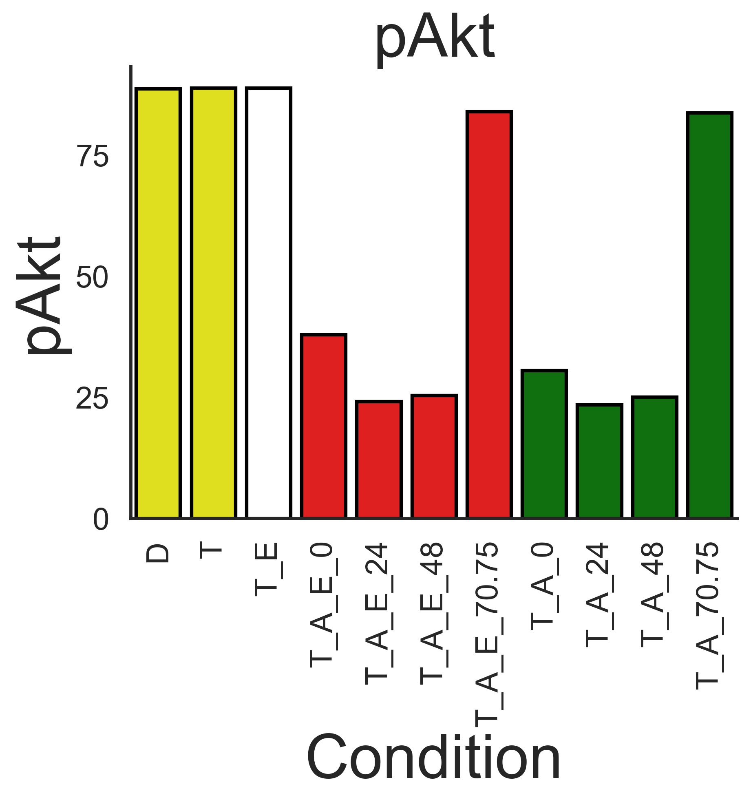
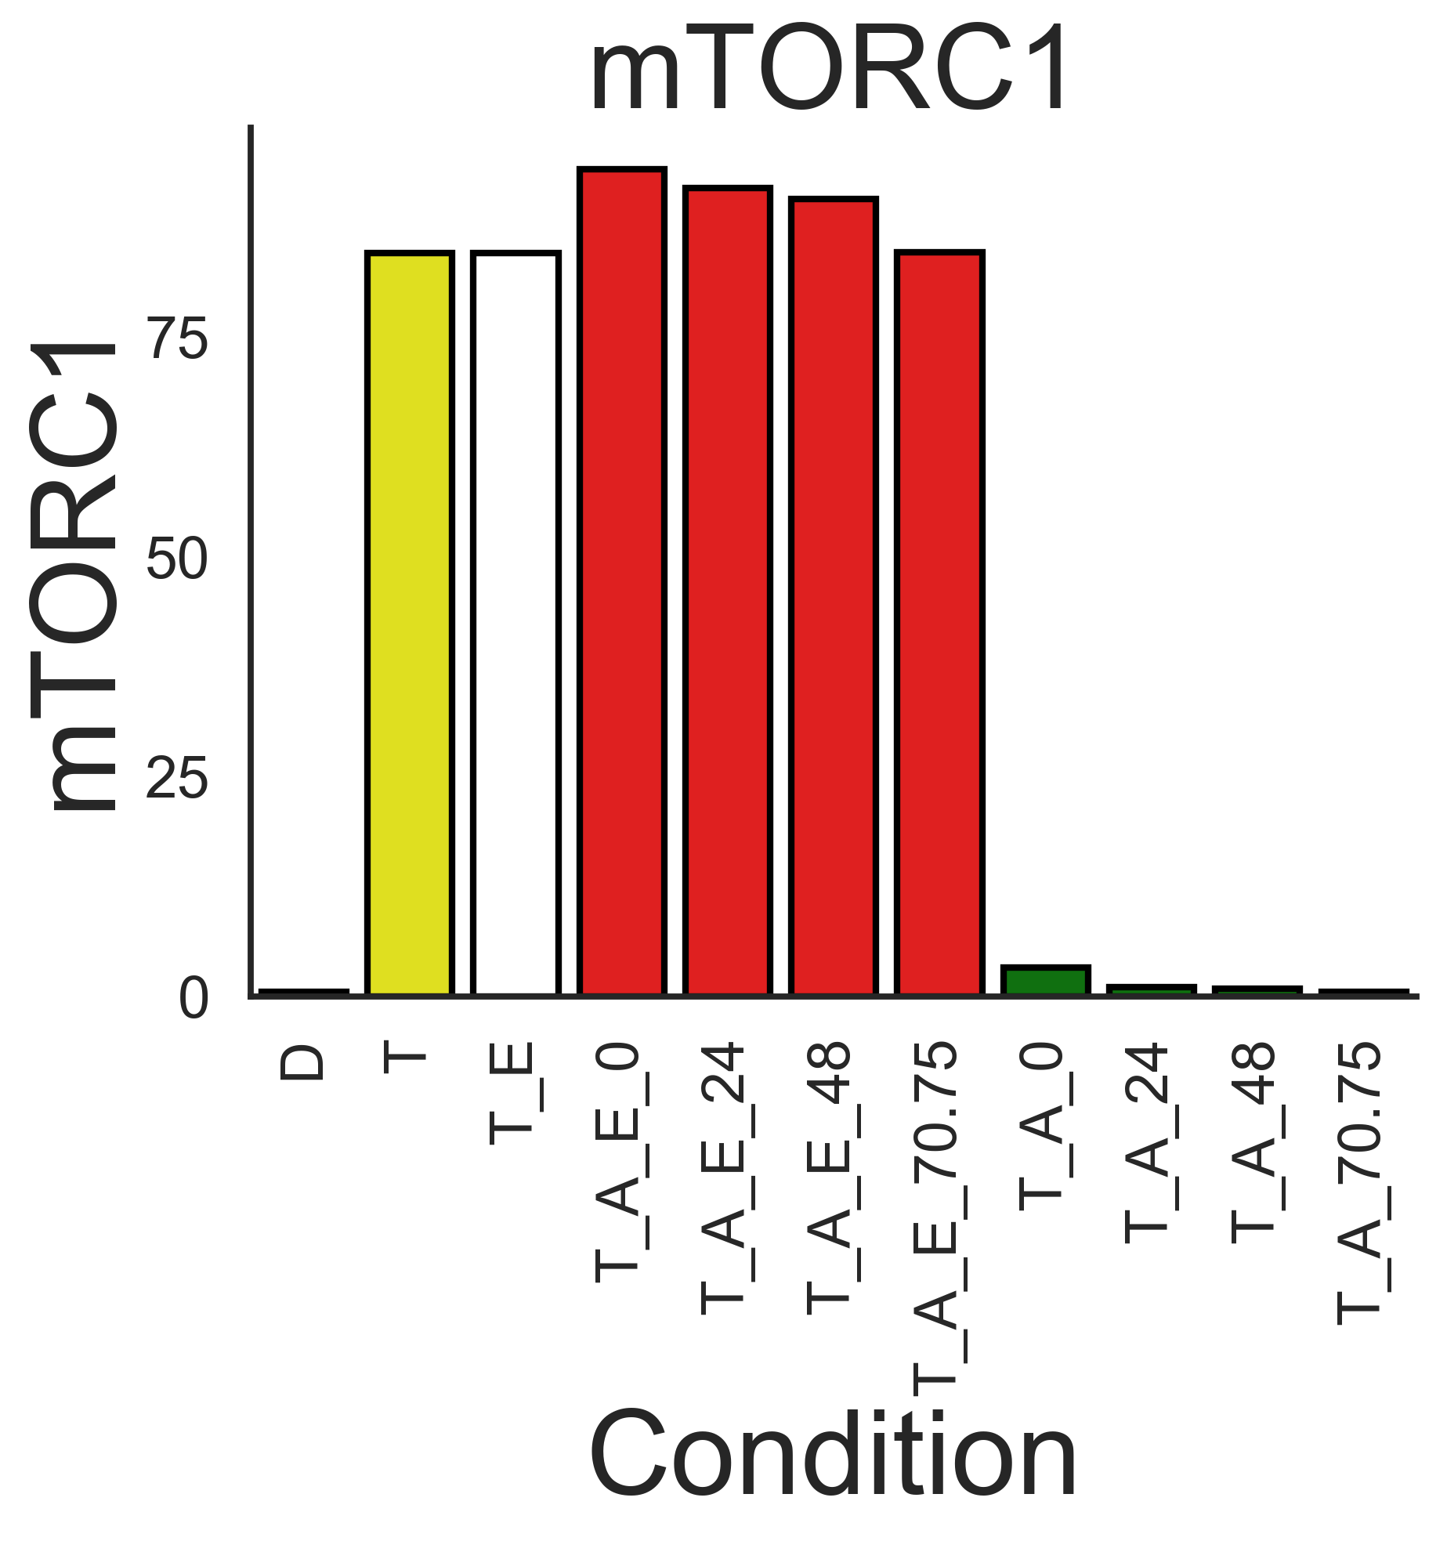
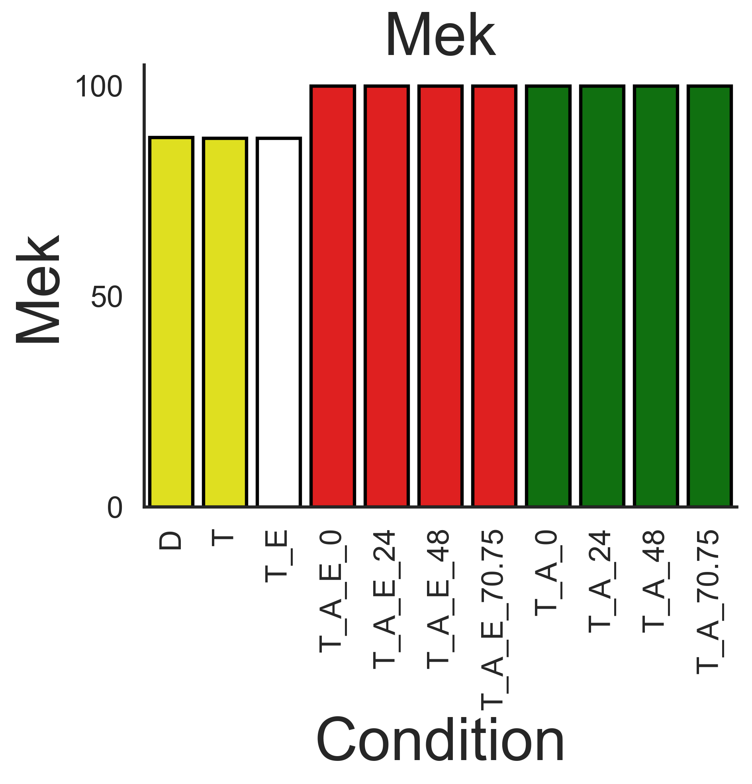

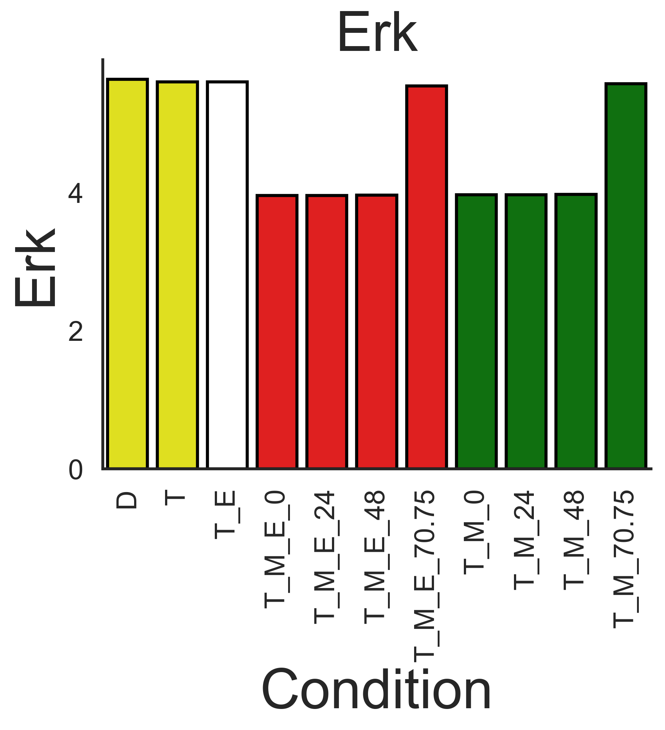
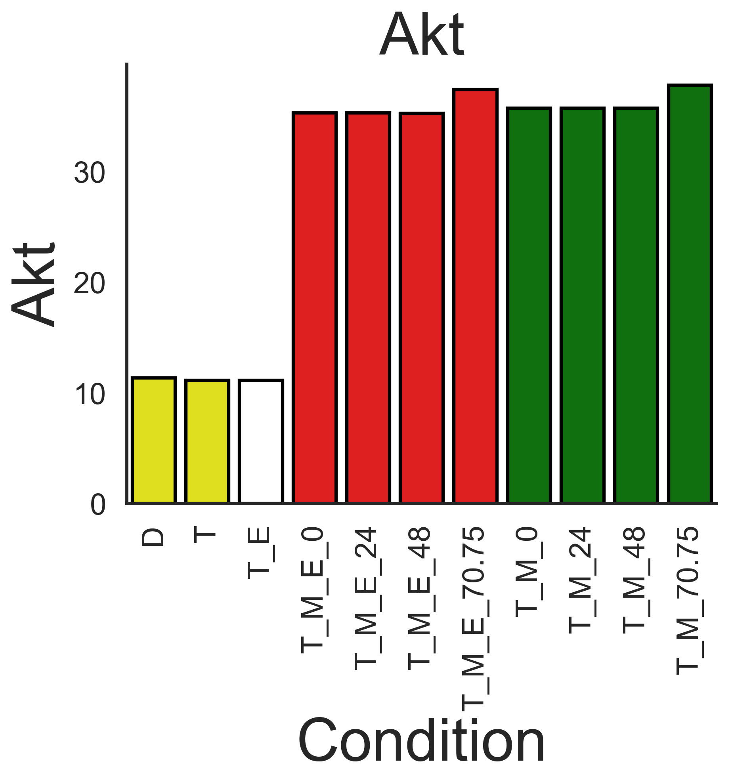
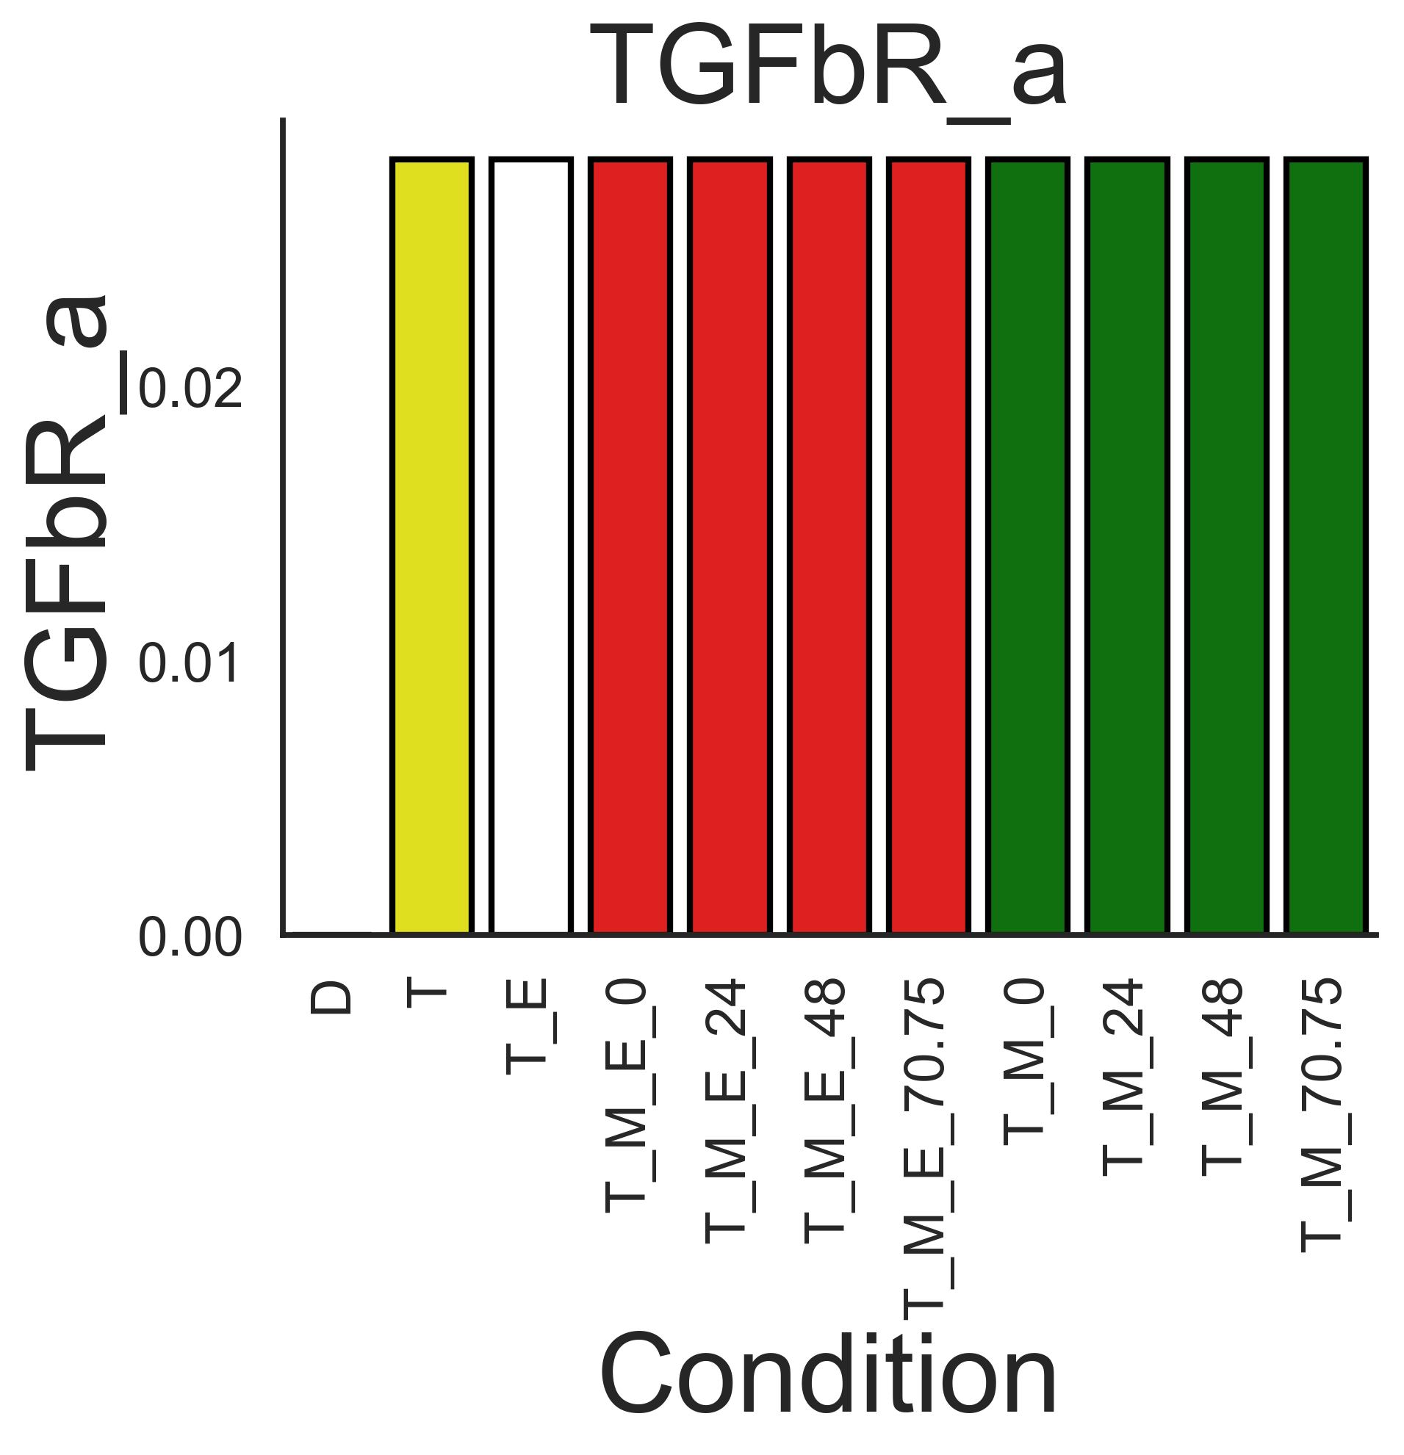
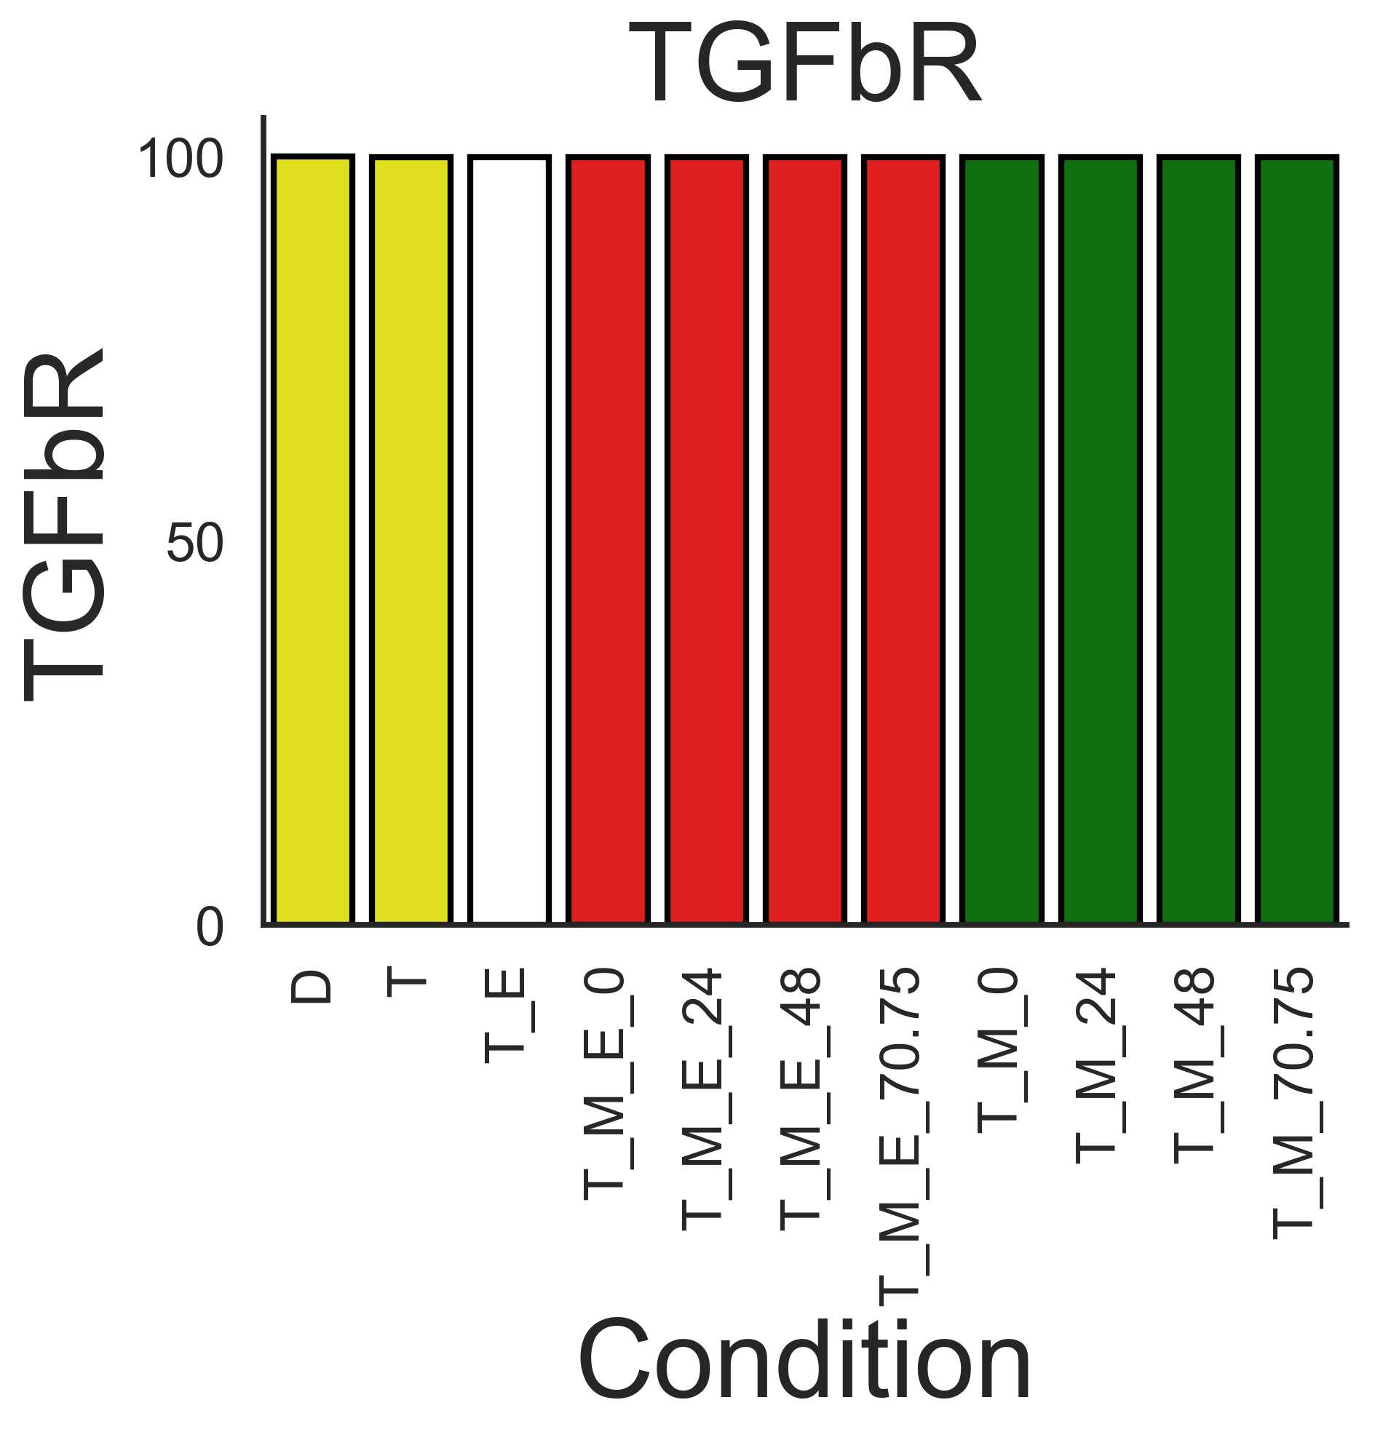
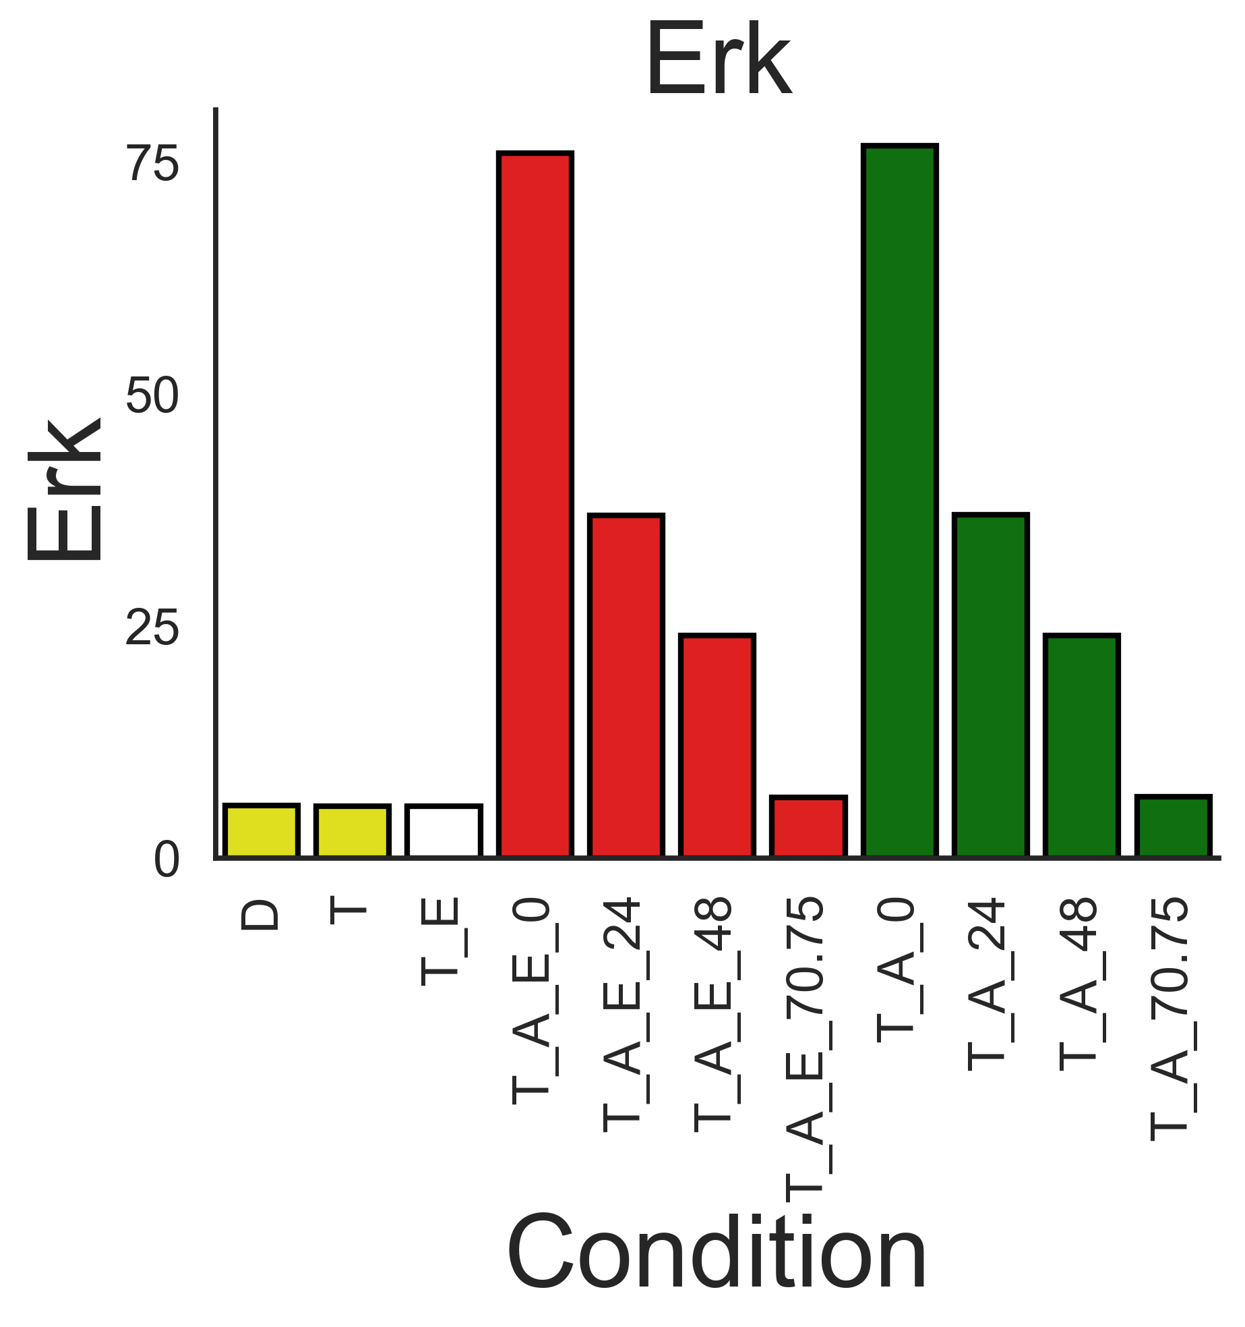
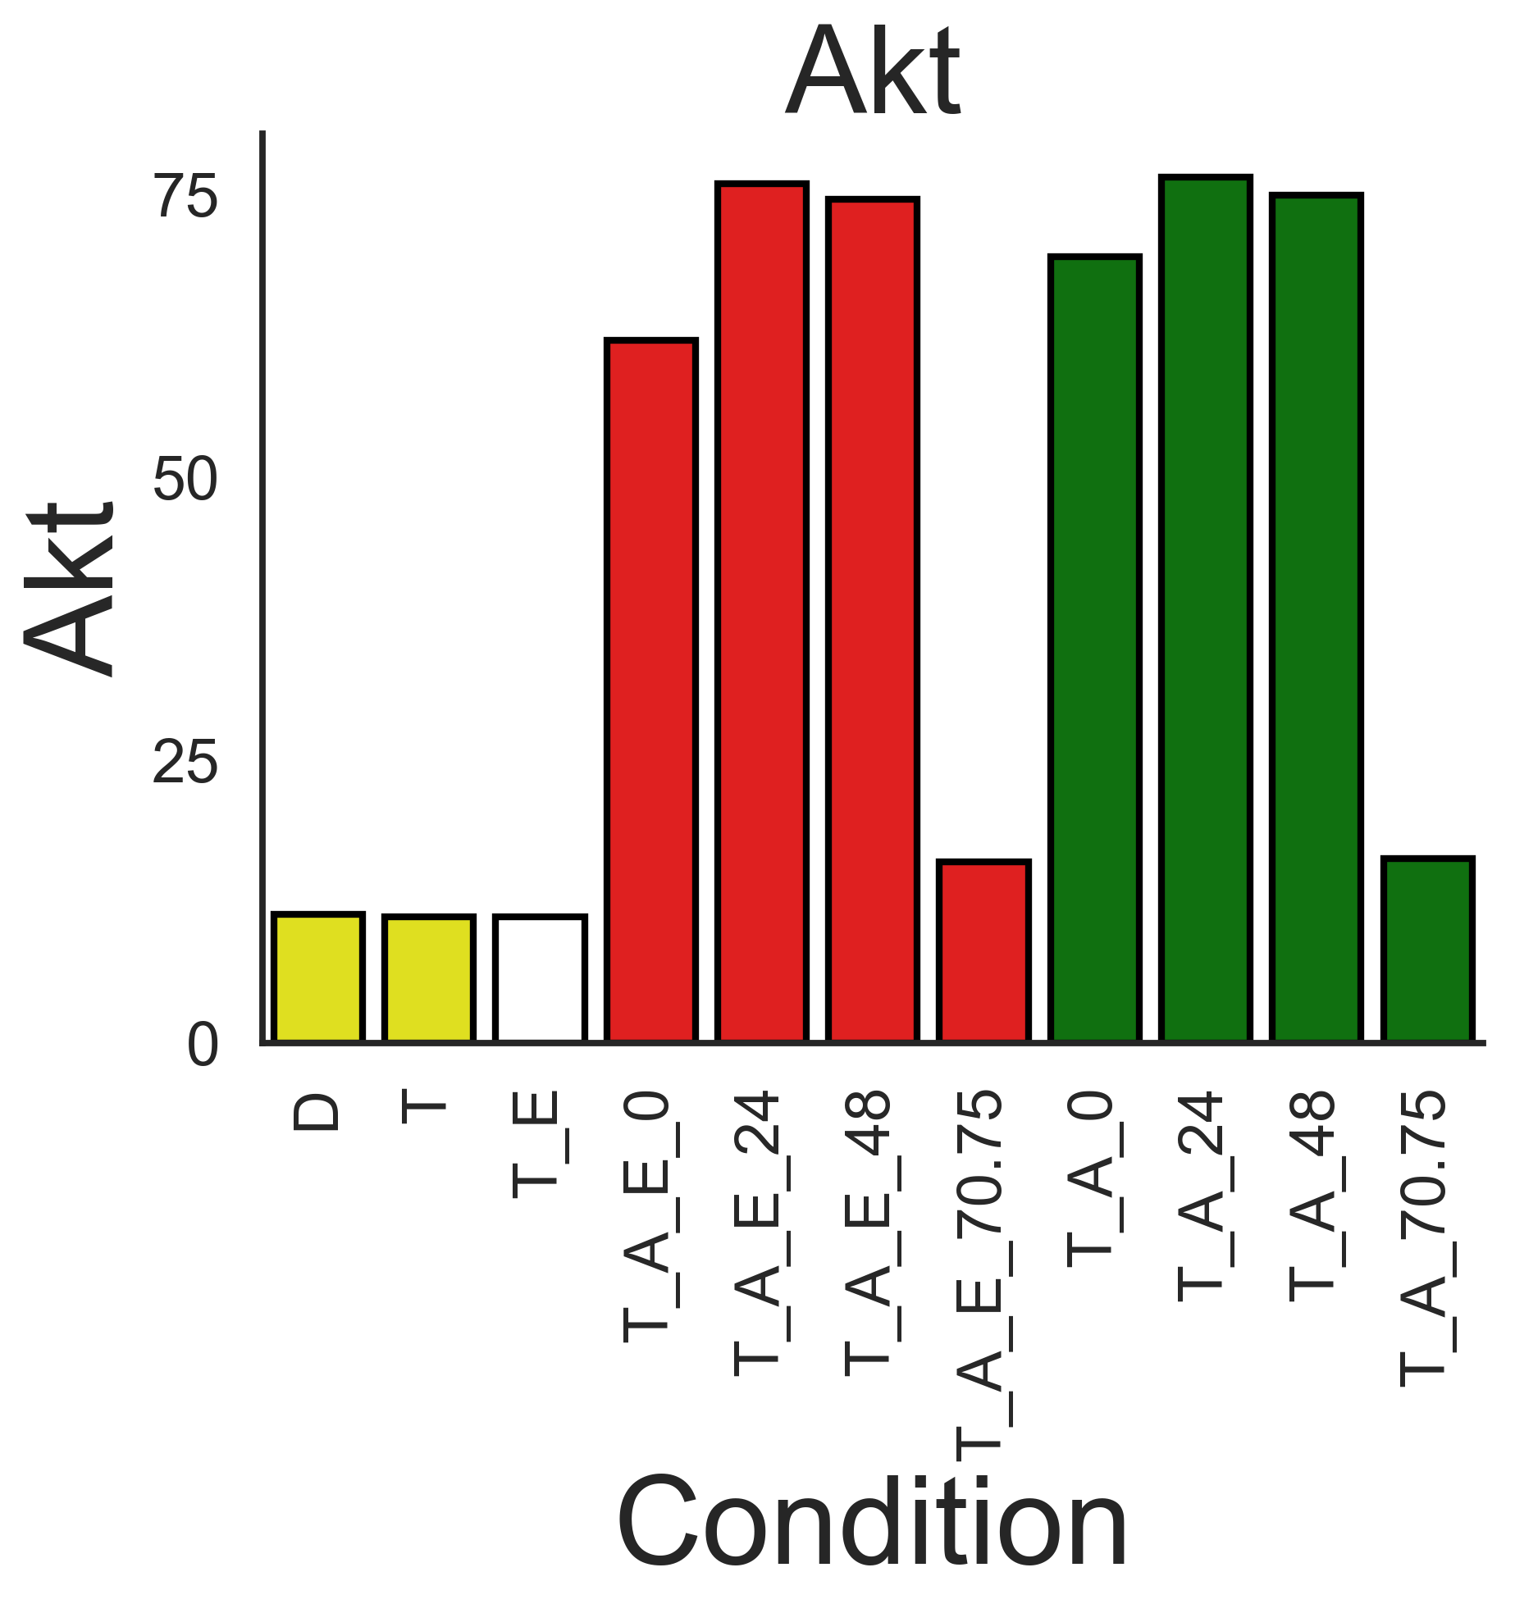
















Simulation output format is now the same as the experimental. Plotted here is the 72h time point from each condition after the appropriate treatment. Now I tweak the model until experimental and simulation interpretations are as similar as possible.
AZD simulations
MK2206 simulations

